Slide 1
Chapter 1: Introduction
What Operating Systems Do
Computer-System Organization
Computer-System Architecture
Operating-System Structure
Operating-System Operations
Process Management
Memory Management
Storage Management
Protection and Security
Kernel Data Structures
Computing Environments
Open-Source Operating Systems

Slide 2
What is an Operating System?
A program that acts as an intermediary between a user of a computer and the computer hardware
Operating system goals:
Execute user programs and make solving user problems easier
Make the computer system convenient to use
Use the computer hardware in an efficient manner

Slide 3
Computer System Structure
Computer system can be divided into four components:
Hardware – provides basic computing resources
CPU, memory, I/O devices
Operating system
Controls and coordinates use of hardware among various applications and users
Application programs – define the ways in which the system resources are used to solve the computing problems of the users
Word processors, compilers, web browsers, database systems, video games
Users
People, machines, other computers

Slide 4
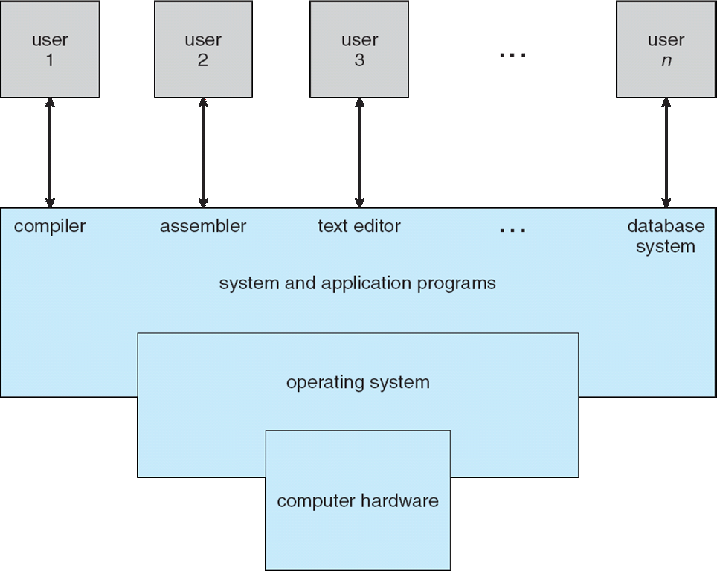
Four Components of a Computer System

Slide 5
What Operating Systems Do
Depends on the point of view
Users want convenience, ease of use and good performance
Don’t care about resource utilization
But shared computer such as mainframe or minicomputer must keep all users happy
Users of dedicate systems such as workstations have dedicated resources but frequently use shared resources from servers
Handheld computers are resource poor, optimized for usability and battery life
Some computers have little or no user interface, such as embedded computers in devices and automobiles

Slide 6
Operating System Definition
OS is a resource allocator
Manages all resources
Decides between conflicting requests for efficient and fair resource use
OS is a control program
Controls execution of programs to prevent errors and improper use of the computer

Slide 7
Operating System Definition (Cont.)
No universally accepted definition
“Everything a vendor ships when you order an operating system” is a good approximation
But varies wildly
“The one program running at all times on the computer” is the kernel.
Everything else is either
a system program (ships with the operating system) , or
an application program.

Slide 8
Computer Startup
bootstrap program is loaded at power-up or reboot
Typically stored in ROM or EPROM, generally known as firmware
Initializes all aspects of system
Loads operating system kernel and starts execution

Slide 9
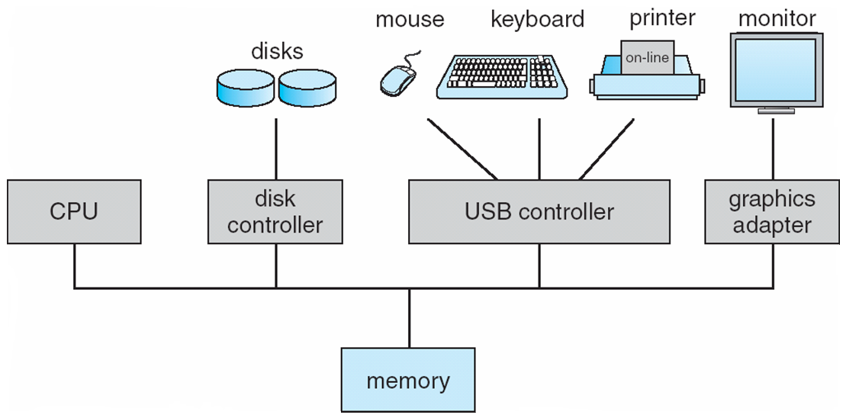
Computer System Organization
Computer-system operation
One or more CPUs, device controllers connect through common bus providing access to shared memory
Concurrent execution of CPUs and devices competing for memory cycles

Slide 10
Computer-System Operation
I/O devices and the CPU can execute concurrently
Each device controller is in charge of a particular device type
Each device controller has a local buffer
CPU moves data from/to main memory to/from local buffers
I/O is from the device to local buffer of controller
Device controller informs CPU that it has finished its operation by causing an interrupt

Slide 11
Common Functions of Interrupts
Interrupt transfers control to the interrupt service routine generally, through the interrupt vector, which contains the addresses of all the service routines
Interrupt architecture must save the address of the interrupted instruction
A trap or exception is a software-generated interrupt caused either by an error or a user request
An operating system is interrupt driven

Slide 12
Interrupt Handling
The operating system preserves the state of the CPU by storing registers and the program counter
Determines which type of interrupt has occurred:
polling
vectored interrupt system
Separate segments of code determine what action should be taken for each type of interrupt

Slide 13
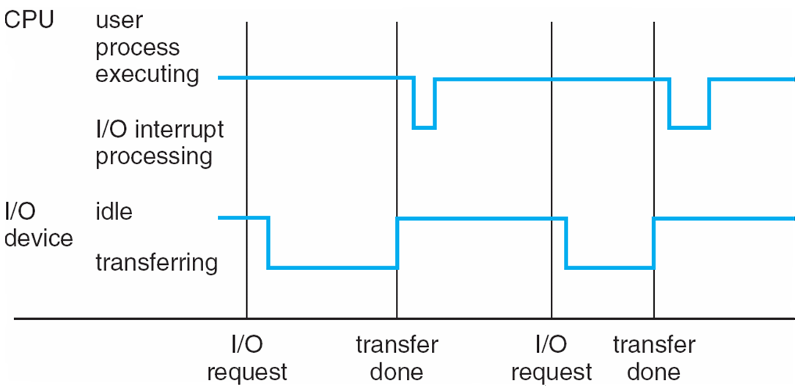
Interrupt Timeline

Slide 14
I/O Structure
After I/O starts, control returns to user program only upon I/O completion
Wait instruction idles the CPU until the next interrupt
Wait loop (contention for memory access)
At most one I/O request is outstanding at a time, no simultaneous I/O processing
After I/O starts, control returns to user program without waiting for I/O completion
System call – request to the OS to allow user to wait for I/O completion
Device-status table contains entry for each I/O device indicating its type, address, and state
OS indexes into I/O device table to determine device status and to modify table entry to include interrupt

Slide 15
Storage Definitions and Notation Review
The basic unit of computer storage is the bit. A bit can contain one of two values, 0 and 1. All other storage in a computer is based on collections of bits. Given enough bits, it is amazing how many things a computer can represent: numbers, letters, images, movies, sounds, documents, and programs, to name a few. A byte is 8 bits, and on most computers it is the smallest convenient chunk of storage. For example, most computers don’t have an instruction to move a bit but do have one to move a byte. A less common term is word, which is a given computer architecture’s native unit of data. A word is made up of one or more bytes. For example, a computer that has 64-bit registers and 64-bit memory addressing typically has 64-bit (8-byte) words. A computer executes many operations in its native word size rather than a byte at a time.
Computer storage, along with most computer throughput, is generally measured and manipulated in bytes and collections of bytes.
A kilobyte, or KB, is 1,024 bytes
a megabyte, or MB, is 1,024² bytes
a gigabyte, or GB, is 1,024³ bytes
a terabyte, or TB, is 1,024⁴ bytes
a petabyte, or PB, is 1,024⁵ bytes
Computer manufacturers often round off these numbers and say that a megabyte is 1 million bytes and a gigabyte is 1 billion bytes. Networking measurements are an exception to this general rule; they are given in bits (because networks move data a bit at a time).

Slide 16
Storage Structure
Main memory – only large storage media that the CPU can access directly
Random access
Typically volatile
Secondary storage – extension of main memory that provides large nonvolatile storage capacity
Hard disks – rigid metal or glass platters covered with magnetic recording material
Disk surface is logically divided into tracks, which are subdivided into sectors
The disk controller determines the logical interaction between the device and the computer
Solid-state disks – faster than hard disks, nonvolatile
Various technologies
Becoming more popular

Slide 17
Storage Hierarchy
Storage systems organized in hierarchy
Speed
Cost
Volatility
Caching – copying information into faster storage system; main memory can be viewed as a cache for secondary storage
Device Driver for each device controller to manage I/O
Provides uniform interface between controller and kernel

Slide 18
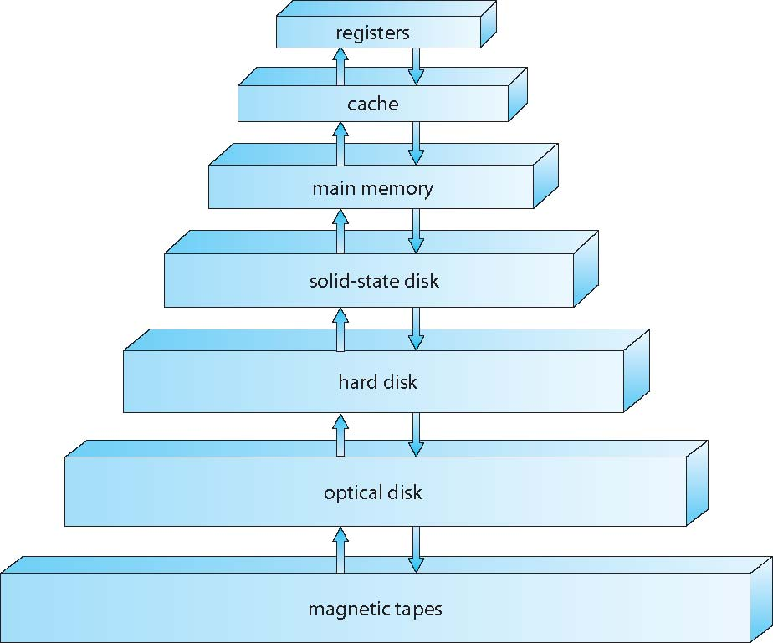
Storage-Device Hierarchy

Slide 19
Caching
Important principle, performed at many levels in a computer (in hardware, operating system, software)
Information in use copied from slower to faster storage temporarily
Faster storage (cache) checked first to determine if information is there
If it is, information used directly from the cache (fast)
If not, data copied to cache and used there
Cache smaller than storage being cached
Cache management important design problem
Cache size and replacement policy

Slide 20
Direct Memory Access Structure
Used for high-speed I/O devices able to transmit information at close to memory speeds
Device controller transfers blocks of data from buffer storage directly to main memory without CPU intervention
Only one interrupt is generated per block, rather than the one interrupt per byte

Slide 21
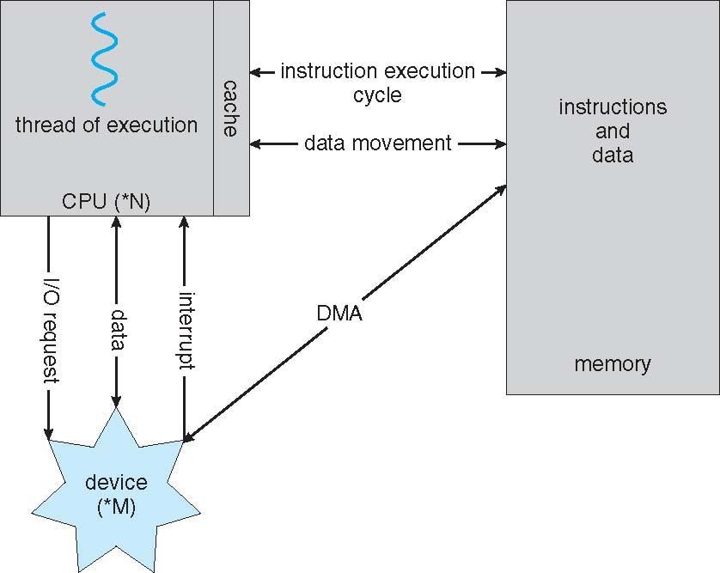
How a Modern Computer Works
A von Neumann architecture

Slide 22
Computer-System Architecture
Most systems use a single general-purpose processor
Most systems have special-purpose processors as well
Multiprocessors systems growing in use and importance
Also known as parallel systems, tightly-coupled systems
Advantages include:
Increased throughput
Economy of scale
Increased reliability – graceful degradation or fault tolerance
Two types:
Asymmetric Multiprocessing – each processor is assigned a specie task.
Symmetric Multiprocessing – each processor performs all tasks

Slide 23
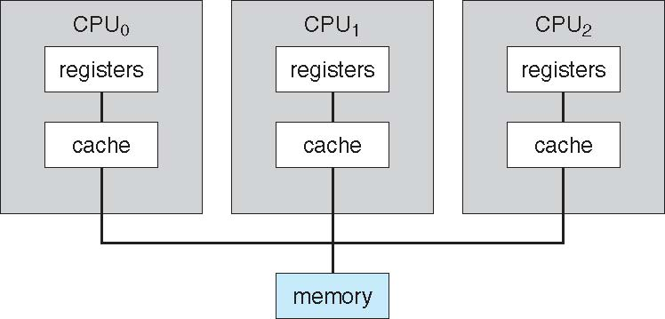
Symmetric Multiprocessing Architecture

Slide 24
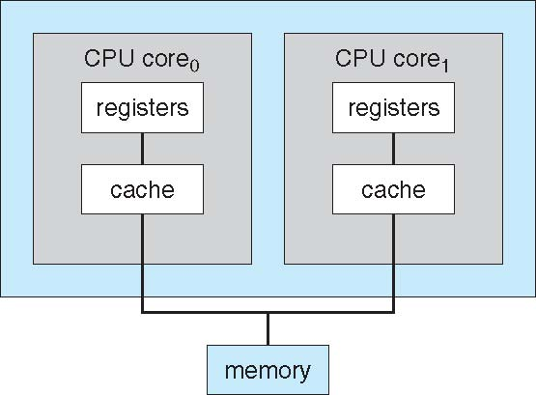
A Dual-Core Design
Multi-chip and multicore
Systems containing all chips
Chassis containing multiple separate systems

Slide 25
Clustered Systems
Like multiprocessor systems, but multiple systems working together
Usually sharing storage via a storage-area network (SAN)
Provides a high-availability service which survives failures
Asymmetric clustering has one machine in hot-standby mode
Symmetric clustering has multiple nodes running applications, monitoring each other
Some clusters are for high-performance computing (HPC)
Applications must be written to use parallelization
Some have distributed lock manager (DLM) to avoid conflicting operations

Slide 26
Clustered Systems

Slide 27
Operating System Structure
Multiprogramming (Batch system) needed for efficiency
Single user cannot keep CPU and I/O devices busy at all times
Multiprogramming organizes jobs (code and data) so CPU always has one to execute
A subset of total jobs in system is kept in memory
One job selected and run via job scheduling
When it has to wait (for I/O for example), OS switches to another job
Timesharing (multitasking) is logical extension in which CPU switches jobs so frequently that users can interact with each job while it is running, creating interactive computing
Response time should be < 1 second
Each user has at least one program executing in memory process
If several jobs ready to run at the same time  CPU scheduling
If processes don’t fit in memory, swapping moves them in and out to run
Virtual memory allows execution of processes not completely in memory

Slide 28
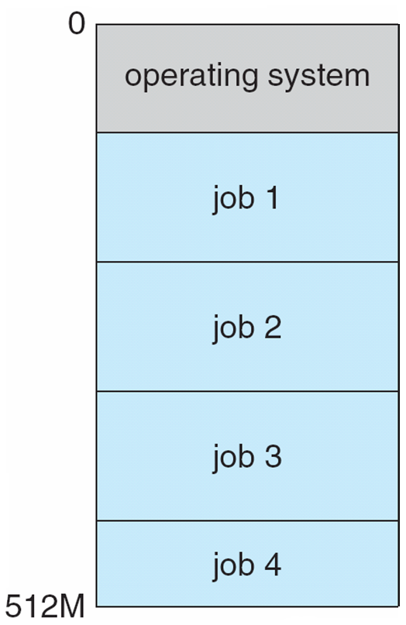
Memory Layout for Multiprogrammed System

Slide 29
Operating-System Operations
Interrupt driven (hardware and software)
Hardware interrupt by one of the devices
Software interrupt (exception or trap):
Software error (e.g., division by zero)
Request for operating system service
Other process problems include infinite loop, processes modifying each other or the operating system

Slide 30
Operating-System Operations (cont.)
Dual-mode operation allows OS to protect itself and other system components
User mode and kernel mode
Mode bit provided by hardware
Provides ability to distinguish when system is running user code or kernel code
Some instructions designated as privileged, only executable in kernel mode
System call changes mode to kernel, return from call resets it to user
Increasingly CPUs support multi-mode operations
i.e. virtual machine manager (VMM) mode for guest VMs

Slide 31
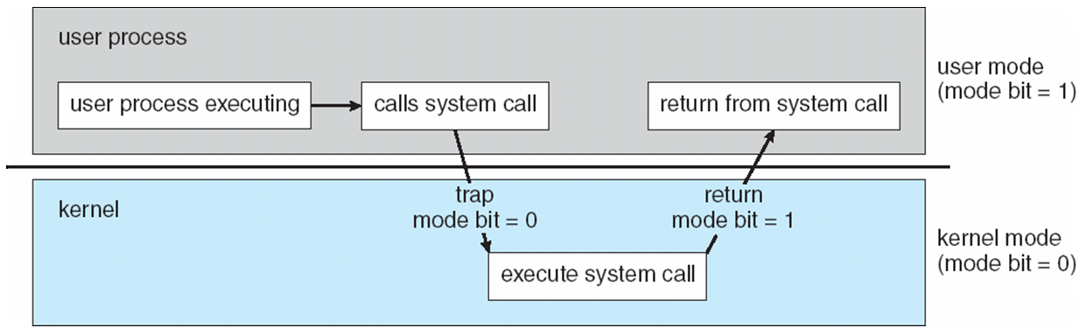
Transition from User to Kernel Mode
Timer to prevent infinite loop / process hogging resources
Timer is set to interrupt the computer after some time period
Keep a counter that is decremented by the physical clock.
Operating system set the counter (privileged instruction)
When counter zero generate an interrupt
Set up before scheduling process to regain control or terminate program that exceeds allotted time

Slide 32
Process Management
A process is a program in execution. It is a unit of work within the system. Program is a passive entity, process is an active entity.
Process needs resources to accomplish its task
CPU, memory, I/O, files
Initialization data
Process termination requires reclaim of any reusable resources
Single-threaded process has one program counter specifying location of next instruction to execute
Process executes instructions sequentially, one at a time, until completion
Multi-threaded process has one program counter per thread
Typically system has many processes, some user, some operating system running concurrently on one or more CPUs
Concurrency by multiplexing the CPUs among the processes / threads

Slide 33
Process Management Activities
The operating system is responsible for the following activities in connection with process management:
Creating and deleting both user and system processes
Suspending and resuming processes
Providing mechanisms for process synchronization
Providing mechanisms for process communication
Providing mechanisms for deadlock handling

Slide 34
Memory Management
To execute a program all (or part) of the instructions must be in memory
All (or part) of the data that is needed by the program must be in memory.
Memory management determines what is in memory and when
Optimizing CPU utilization and computer response to users
Memory management activities
Keeping track of which parts of memory are currently being used and by whom
Deciding which processes (or parts thereof) and data to move into and out of memory
Allocating and deallocating memory space as needed

Slide 35
Storage Management
OS provides uniform, logical view of information storage
Abstracts physical properties to logical storage unit - file
Each medium is controlled by device (i.e., disk drive, tape drive)
Varying properties include access speed, capacity, data-transfer rate, access method (sequential or random)
File-System management
Files usually organized into directories
Access control on most systems to determine who can access what
OS activities include
Creating and deleting files and directories
Primitives to manipulate files and directories
Mapping files onto secondary storage
Backup files onto stable (non-volatile) storage media

Slide 36
Mass-Storage Management
Usually disks used to store data that does not fit in main memory or data that must be kept for a “long” period of time
Proper management is of central importance
Entire speed of computer operation hinges on disk subsystem and its algorithms
OS activities
Free-space management
Storage allocation
Disk scheduling
Some storage need not be fast
Tertiary storage includes optical storage, magnetic tape
Still must be managed – by OS or applications
Varies between WORM (write-once, read-many-times) and RW (read-write)

Slide 37
Performance of Various Levels of Storage
Movement between levels of storage hierarchy can be explicit or implicit

Slide 38
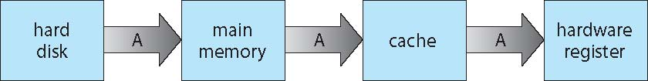
Migration of data “A” from Disk to Register
Multitasking environments must be careful to use most recent value, no matter where it is stored in the storage hierarchy
Multiprocessor environment must provide cache coherency in hardware such that all CPUs have the most recent value in their cache
Distributed environment situation even more complex
Several copies of a datum can exist
Various solutions covered in Chapter 17

Slide 39
I/O Subsystem
One purpose of OS is to hide peculiarities of hardware devices from the user
I/O subsystem responsible for
Memory management of I/O including buffering (storing data temporarily while it is being transferred), caching (storing parts of data in faster storage for performance), spooling (the overlapping of output of one job with input of other jobs)
General device-driver interface
Drivers for specific hardware devices

Slide 40
Protection and Security
Protection – any mechanism for controlling access of processes or users to resources defined by the OS
Security – defense of the system against internal and external attacks
Huge range, including denial-of-service, worms, viruses, identity theft, theft of service
Systems generally first distinguish among users, to determine who can do what
User identities (user IDs, security IDs) include name and associated number, one per user
User ID then associated with all files, processes of that user to determine access control
Group identifier (group ID) allows set of users to be defined and controls managed, then also associated with each process, file
Privilege escalation allows user to change to effective ID with more rights

Slide 41
Kernel Data Structures
Many similar to standard programming data structures
Singly linked list
Doubly linked list
Circular linked list

Slide 42
Kernel Data Structures
Binary search tree left <= right
Search performance is O(n)
Balanced binary search tree is O(lg n)

Slide 43
Kernel Data Structures
Hash function can create a hash map
Bitmap – string of n binary digits representing the status of n items
Linux data structures defined in
include files <linux/list.h>, <linux/kfifo.h>, <linux/rbtree.h>

Slide 44
Computing Environments - Traditional
Stand-alone general purpose machines
But blurred as most systems interconnect with others (i.e., the Internet)
Portals provide web access to internal systems
Network computers (thin clients) are like Web terminals
Mobile computers interconnect via wireless networks
Networking becoming ubiquitous – even home systems use firewalls to protect home computers from Internet attacks

Slide 45
Computing Environments - Mobile
Handheld smartphones, tablets, etc
What is the functional difference between them and a “traditional” laptop?
Extra feature – more OS features (GPS, gyroscope)
Allows new types of apps like augmented reality
Use IEEE 802.11 wireless, or cellular data networks for connectivity
Leaders are Apple iOS and Google Android

Slide 46
Computing Environments – Distributed
Distributed computiing
Collection of separate, possibly heterogeneous, systems networked together
Network is a communications path, TCP/IP most common
Local Area Network (LAN)
Wide Area Network (WAN)
Metropolitan Area Network (MAN)
Personal Area Network (PAN)
Network Operating System provides features between systems across network
Communication scheme allows systems to exchange messages
Illusion of a single system

Slide 47
Computing Environments – Client-Server
Client-Server Computing
Dumb terminals supplanted by smart PCs
Many systems now servers, responding to requests generated by clients
Compute-server system provides an interface to client to request services (i.e., database)
File-server system provides interface for clients to store and retrieve files

Slide 48
Computing Environments - Peer-to-Peer
Another model of distributed system
P2P does not distinguish clients and servers
Instead all nodes are considered peers
May each act as client, server or both
Node must join P2P network
Registers its service with central lookup service on network, or
Broadcast request for service and respond to requests for service via discovery protocol
Examples include Napster and Gnutella, Voice over IP (VoIP) such as Skype

Slide 49
Computing Environments - Virtualization
Allows operating systems to run applications within other OSes
Vast and growing industry
Emulation used when source CPU type different from target type (i.e. PowerPC to Intel x86)
Generally slowest method
When computer language not compiled to native code – Interpretation
Virtualization – OS natively compiled for CPU, running guest OSes also natively compiled
Consider VMware running WinXP guests, each running applications, all on native WinXP host OS
VMM (virtual machine Manager) provides virtualization services

Slide 50
Computing Environments - Virtualization
Use cases involve laptops and desktops running multiple OSes for exploration or compatibility
Apple laptop running Mac OS X host, Windows as a guest
Developing apps for multiple OSes without having multiple systems
QA testing applications without having multiple systems
Executing and managing compute environments within data centers
VMM can run natively, in which case they are also the host
There is no general purpose host then (VMware ESX and Citrix XenServer)

Slide 51
Computing Environments - Virtualization

Slide 52
Computing Environments – Cloud Computing
Delivers computing, storage, even apps as a service across a network
Logical extension of virtualization because it uses virtualization as the base for it functionality.
Amazon EC2 has thousands of servers, millions of virtual machines, petabytes of storage available across the Internet, pay based on usage
Many types
Public cloud – available via Internet to anyone willing to pay
Private cloud – run by a company for the company’s own use
Hybrid cloud – includes both public and private cloud components
Software as a Service (SaaS) – one or more applications available via the Internet (i.e., word processor)
Platform as a Service (PaaS) – software stack ready for application use via the Internet (i.e., a database server)
Infrastructure as a Service (IaaS) – servers or storage available over Internet (i.e., storage available for backup use)

Slide 53
Computing Environments – Cloud Computing
Cloud computing environments composed of traditional OSes, plus VMMs, plus cloud management tools
Internet connectivity requires security like firewalls
Load balancers spread traffic across multiple applications

Slide 54
Computing Environments – Real-Time Embedded Systems
Real-time embedded systems most prevalent form of computers
Vary considerable, special purpose, limited purpose OS, real-time OS
Use expanding
Many other special computing environments as well
Some have OSes, some perform tasks without an OS
Real-time OS has well-defined fixed time constraints
Processing must be done within constraint
Correct operation only if constraints met

Slide 55
Open-Source Operating Systems
Operating systems made available in source-code format rather than just binary closed-source
Counter to the copy protection and Digital Rights Management (DRM) movement
Started by Free Software Foundation (FSF), which has “copyleft” GNU Public License (GPL)
Examples include GNU/Linux and BSD UNIX (including core of Mac OS X), and many more
Can use VMM like VMware Player (Free on Windows), Virtualbox (open source and free on many platforms - http://www.virtualbox.com)
Use to run guest operating systems for exploration

Slide 56
Chapter 3: Processes
Process Concept
Process Scheduling
Operations on Processes
Interprocess Communication
Examples of IPC Systems
Communication in Client-Server Systems

Slide 57
Objectives
A program in execution, which forms the basis of all computation
To describe the various features of processes, including scheduling, creation and termination, and communication
To explore interprocess communication using shared memory and message passing
To describe communication in client-server systems

Slide 58
Process Concept
An operating system executes a variety of programs:
Batch system – jobs
Time-shared systems – user programs or tasks
Textbook uses the terms job and process almost interchangeably
Process – a program in execution; process execution must progress in sequential fashion
Multiple parts
The program code, also called text section
Current activity including program counter, processor registers
Stack containing temporary data
Function parameters, return addresses, local variables
Data section containing global variables
Heap containing memory dynamically allocated during run time

Slide 59
Process Concept (Cont.)
Program is passive entity stored on disk (executable file), process is active entity (with a PC specifying the next instruction to execute)
Program becomes process when executable file loaded into memory
Execution of program started via GUI mouse clicks, command line entry of its name, etc
One program can be associated with several processes
Consider multiple users executing the same program

Slide 60
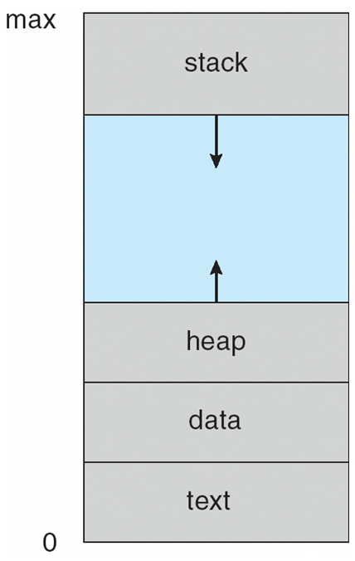
Process in Memory

Slide 61
Process State
As a process executes, it changes state
new: The process is being created
running: Instructions are being executed
waiting: The process is waiting for some event to occur
ready: The process is waiting to be assigned to a processor
terminated: The process has finished execution

Slide 62
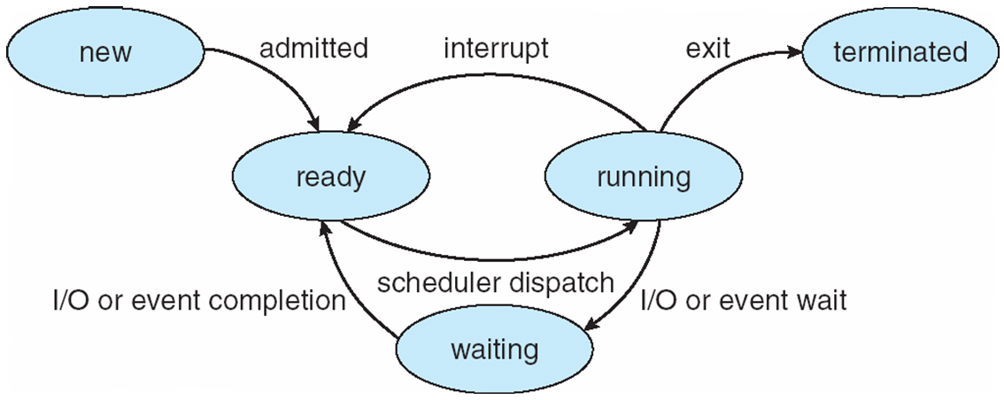
Diagram of Process State

Slide 63
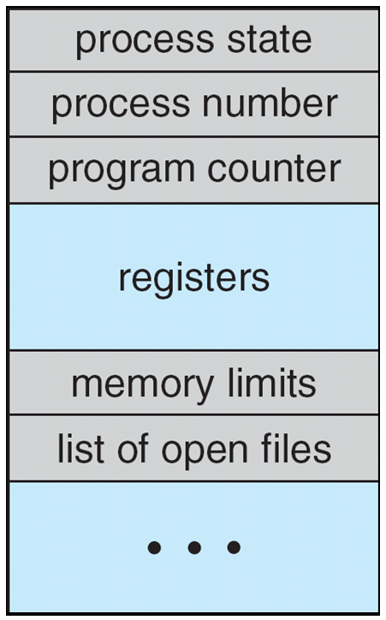
Process Control Block (PCB)
Information associated with each process
(also called process control block)
Process state – running, waiting, etc
Program counter – location of instruction to next execute
CPU registers – contents of all process-centric registers
CPU scheduling information- priorities, scheduling queue pointers
Memory-management information – memory allocated to the process
Accounting information – CPU used, clock time elapsed since start, time limits
I/O status information – I/O devices allocated to process, list of open files

Slide 64
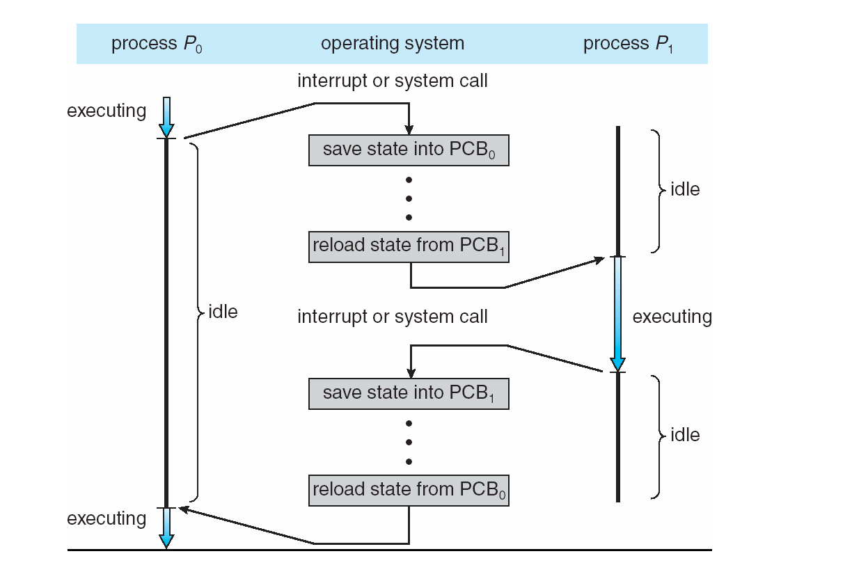
CPU Switch From Process to Process

Slide 65
Process Scheduling
Maximize CPU use, quickly switch processes onto CPU for time sharing
Process scheduler selects among available processes for next execution on CPU
Maintains scheduling queues of processes
Job queue – set of all processes in the system
Ready queue – set of all processes residing in main memory, ready and waiting to execute
Device queues – set of processes waiting for an I/O device
Processes migrate among the various queues

Slide 66
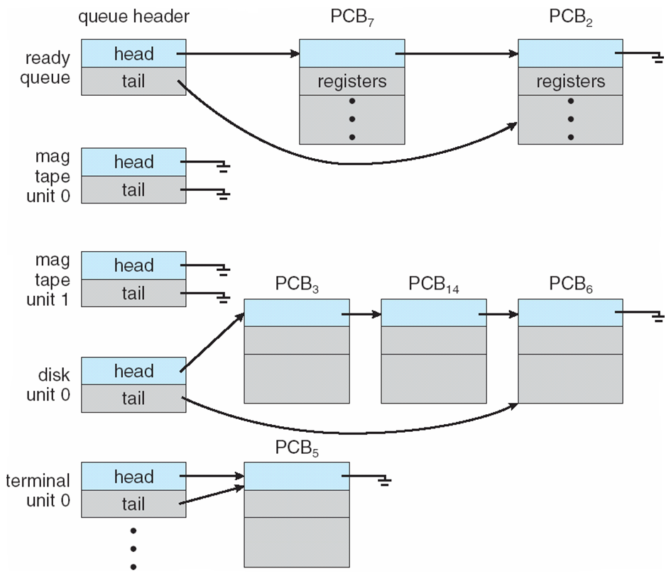
Ready Queue And Various I/O Device Queues

Slide 67
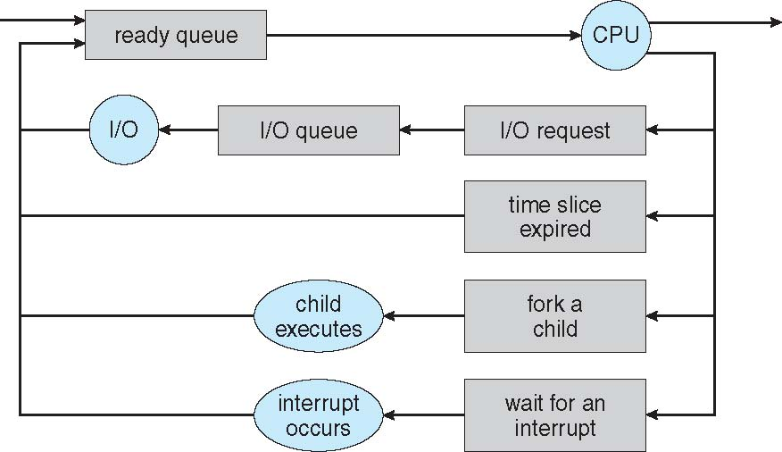
Representation of Process Scheduling
Queueing diagram represents queues, resources, flows

Slide 68
Schedulers
Short-term scheduler (or CPU scheduler) – selects which process should be executed next and allocates CPU
Sometimes the only scheduler in a system
Short-term scheduler is invoked frequently (milliseconds) ⇒ (must be fast)
Long-term scheduler (or job scheduler) – selects which processes should be brought into the ready queue
Long-term scheduler is invoked infrequently (seconds, minutes) ⇒ (may be slow)
The long-term scheduler controls the degree of multiprogramming
Processes can be described as either:
I/O-bound process – spends more time doing I/O than doing computations, many short CPU bursts
CPU-bound process – spends more time doing computations; few very long CPU bursts
Long-term scheduler strives for good process mix of CPU bound and I/O bound

Slide 69
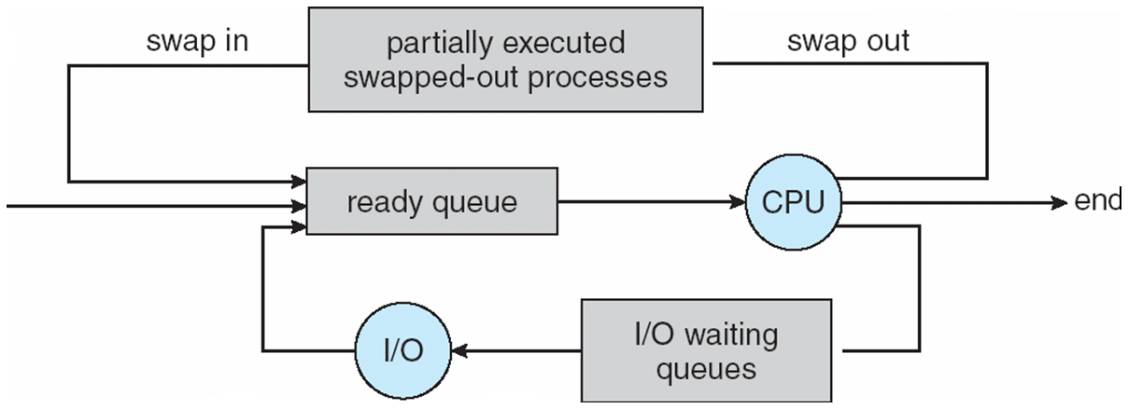
Addition of Medium Term Scheduling
Medium-term scheduler can be added if degree of multiple programming needs to decrease
Remove process from memory, store on disk, bring back in from disk to continue execution: swapping
Swapping is necessary to improve the process mix

Slide 70
Context Switch
When CPU switches to another process, the system must save the state of the old process and load the saved state for the new process via a context switch
Context of a process represented in the PCB (values of CPU registers, process state and memory mgmnt information)
Context-switch time is overhead; the system does no useful work while switching
The more complex the OS and the PCB ➔ the longer the context switch
Time dependent on hardware support
Some hardware provides multiple sets of registers per CPU ➔ multiple contexts loaded at once

Slide 71
Operations on Processes
System must provide mechanisms for:
process creation,
process termination

Slide 72
Process Creation
Parent process create children processes, which, in turn create other processes, forming a tree of processes
Generally, process identified and managed via a process identifier (pid)
Resource sharing options
Parent and children share all resources
Children share subset of parent’s resources
Execution options
Parent and children execute concurrently
Parent waits until children terminate

Slide 73
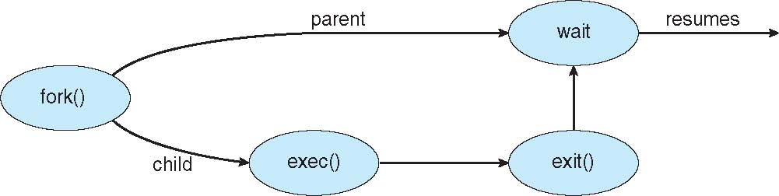
Process Creation (Cont.)
Address space
Child duplicate of parent
Child has a program loaded into it
UNIX examples
fork() system call creates new process
exec() system call used after a fork() to replace the process’ memory space with a new program

Slide 74
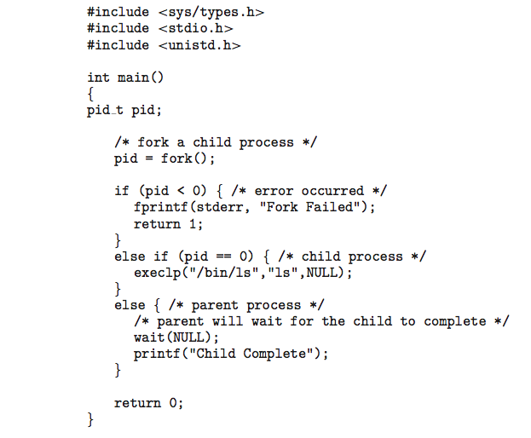
C Program Forking Separate Process

Slide 75
Process Termination
Process executes last statement and then asks the operating system to delete it using the exit() system call.
Returns status data from child to parent (via wait())
Process’ resources are deallocated by operating system
Parent may terminate the execution of children processes using the abort() system call. Some reasons for doing so:
Child has exceeded allocated resources
Task assigned to child is no longer required
The parent is exiting and the operating systems does not allow a child to continue if its parent terminates (cascading termination)

Slide 76
Process Termination
Some operating systems do not allow child to exists if its parent has terminated. If a process terminates, then all its children must also be terminated.
cascading termination. All children, grandchildren, etc. are terminated.
The termination is initiated by the operating system.
The parent process may wait for termination of a child process by using the wait()system call. The call returns status information and the pid of the terminated process
pid = wait(&status);

Slide 77
Cooperating Processes
Independent process cannot affect or be affected by the execution of another process
Cooperating process can affect or be affected by the execution of another process
Advantages of process cooperation
Information sharing
Computation speed-up
Modularity
Convenience

Slide 78
Producer-Consumer Problem
Paradigm for cooperating processes, producer process produces information that is consumed by a consumer process
unbounded-buffer places no practical limit on the size of the buffer
bounded-buffer assumes that there is a fixed buffer size

Slide 79
Bounded-Buffer – Shared-Memory Solution
Shared data
#define BUFFER_SIZE 10
typedef struct {
. . .
} item;
item buffer[BUFFER_SIZE];
int in = 0;
int out = 0;
Solution is correct, but can only use BUFFER_SIZE-1 elements

Slide 80
Bounded-Buffer – Producer
item next_produced;
while (true) {
/* produce an item in next produced */
while (((in + 1) % BUFFER_SIZE) == out)
; /* do nothing */
buffer[in] = next_produced;
in = (in + 1) % BUFFER_SIZE;
}

Slide 81
Bounded Buffer – Consumer
item next_consumed;
while (true) { while (in == out)
; /* do nothing */ next_consumed = buffer[out];
out = (out + 1) % BUFFER_SIZE;
/* consume the item in next consumed */
}

Slide 82
Interprocess Communication
Cooperating processes need interprocess communication (IPC)
Two models of IPC
Shared memory
Message passing

Slide 83
Communications Models
(a) Message passing. (b) shared memory.

Slide 84
Interprocess Communication – Shared Memory
An area of memory shared among the processes that wish to communicate
The communication is under the control of the users processes not the operating system.
Major issues is to provide mechanism that will allow the user processes to synchronize their actions when they access shared memory.

Slide 85
Interprocess Communication – Message Passing
IPC provides mechanism for processes to communicate and to synchronize their actions (without sharing same address space)
Message system – processes communicate with each other without resorting to shared variables
IPC facility provides two operations:
send(message)
receive(message)
The message size is either fixed or variable

Slide 86
Message Passing (Cont.)
If processes P and Q wish to communicate, they need to:
Establish a communication link between them
Exchange messages via send/receive
Implementation issues:
Not concerned with the link’s physical implementation but rather its logical implementation

Slide 87
Message Passing (Cont.)
Implementation of communication link
Physical:
Shared memory
Hardware bus
Network
Logical:
Direct or indirect
Synchronous or asynchronous
Automatic or explicit buffering

Slide 88
Direct Communication
Processes must name each other explicitly:
send (P, message) – send a message to process P
receive(Q, message) – receive a message from process Q
Properties of communication link
Links are established automatically (know only the each other’s identity)
A link is associated with exactly one pair of communicating processes
Between each pair there exists exactly one link
The link may be unidirectional, but is usually bi-directional

Slide 89
Indirect Communication
Messages are directed and received from mailboxes (also referred to as ports)
Each mailbox has a unique id
Processes can communicate only if they share a mailbox
Properties of communication link
Link established only if processes share a common mailbox
A link may be associated with many processes
Each pair of processes may share several communication links
Link may be unidirectional or bi-directional
This scheme exhibits symmetry in addressing

Slide 90
Indirect Communication
Operations
create a new mailbox (port)
send and receive messages through mailbox
destroy a mailbox
Primitives are defined as:
send(A, message) – send a message to mailbox A
receive(A, message) – receive a message from mailbox A

Slide 91
Indirect Communication
Mailbox sharing
P₁, P₂, and P₃ share mailbox A
P₁, sends; P₂ and P₃ receive
Who gets the message?
Solutions
Allow a link to be associated with at most two processes
Allow only one process at a time to execute a receive operation
Allow the system to select arbitrarily the receiver. Sender is notified who the receiver was.

Slide 92
Synchronization
Message passing may be either blocking or non-blocking
Blocking is considered synchronous
Blocking send -- the sender is blocked until the message is received
Blocking receive -- the receiver is blocked until a message is available
Non-blocking is considered asynchronous
Non-blocking send -- the sender sends the message and continue
Non-blocking receive -- the receiver receives:
A valid message, or
Null message

Slide 93
Buffering
Queue of messages attached to the link.
implemented in one of three ways
1. Zero capacity – no messages are queued on a link. Sender must wait for receiver (rendezvous)
2. Bounded capacity – finite length of n messages Sender must wait if link full
3. Unbounded capacity – infinite length Sender never waits

Slide 94
Chapter 6: CPU Scheduling
Basic Concepts
Scheduling Criteria
Scheduling Algorithms
Thread Scheduling
Multiple-Processor Scheduling
Real-Time CPU Scheduling
Operating Systems Examples
Algorithm Evaluation

Slide 95
Objectives
To introduce CPU scheduling, which is the basis for multiprogrammed operating systems
To describe various CPU-scheduling algorithms
To discuss evaluation criteria for selecting a CPU-scheduling algorithm for a particular system
To examine the scheduling algorithms of several operating systems

Slide 96
Basic Concepts
Maximum CPU utilization obtained with multiprogramming
CPU–I/O Burst Cycle – Process execution consists of a cycle of CPU execution and I/O wait
CPU burst followed by I/O burst
CPU burst distribution is of main concern

Slide 97
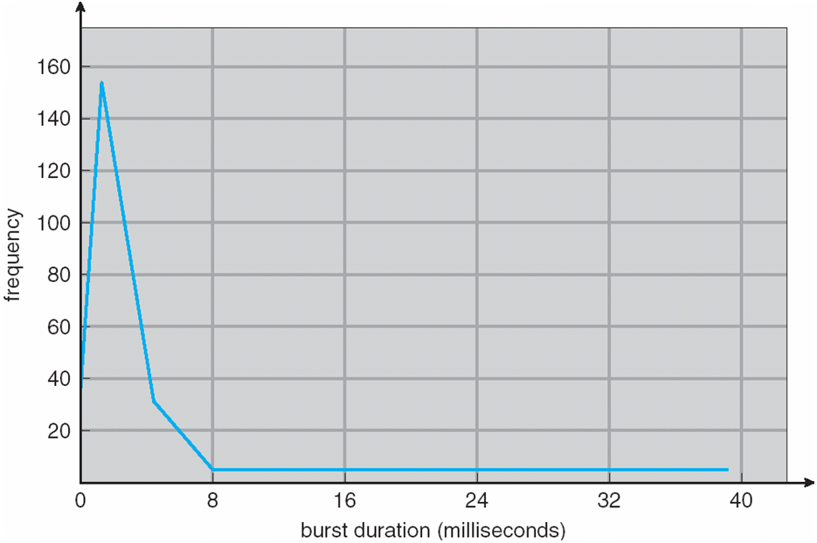
Histogram of CPU-burst Times

Slide 98
CPU Scheduler
Short-term scheduler selects from among the processes in ready queue, and allocates the CPU to one of them
Queue may be ordered in various ways
CPU scheduling decisions may take place when a process:
1. Switches from running to waiting state
2. Switches from running to ready state
3. Switches from waiting to ready
Terminates
Scheduling under 1 and 4 is nonpreemptive
All other scheduling is preemptive
Consider access to shared data
Consider preemption while in kernel mode
Consider interrupts occurring during crucial OS activities

Slide 99
Dispatcher
Dispatcher module gives control of the CPU to the process selected by the short-term scheduler; this involves:
switching context
switching to user mode
jumping to the proper location in the user program to restart that program
Dispatch latency – time it takes for the dispatcher to stop one process and start another running

Slide 100
Scheduling Criteria
CPU utilization – keep the CPU as busy as possible
Throughput – # of processes that complete their execution per time unit
Turnaround time – amount of time to execute a particular process
Waiting time – amount of time a process has been waiting in the ready queue
Response time – amount of time it takes from when a request was submitted until the first response is produced, not output (for time-sharing environment)

Slide 101
Scheduling Algorithm Optimization Criteria
Max CPU utilization
Max throughput
Min turnaround time
Min waiting time
Min response time

Slide 102
First- Come, First-Served (FCFS) Scheduling
Process Burst Time
P₁ 24
P₂ 3
P₃ 3
Suppose that the processes arrive in the order: P₁ , P₂ , P₃ The Gantt Chart for the schedule is:
Waiting time for P₁ = 0; P₂ = 24; P₃ = 27
Average waiting time: (0 + 24 + 27)/3 = 17

Slide 103
FCFS Scheduling (Cont.)
Suppose that the processes arrive in the order:
P₂ , P₃ , P₁
The Gantt chart for the schedule is:
Waiting time for P₁ = 6; P₂ = 0; P₃ = 3
Average waiting time: (6 + 0 + 3)/3 = 3
Much better than previous case
Convoy effect - short process behind long process
Consider one CPU-bound and many I/O-bound processes

Slide 104
Shortest-Job-First (SJF) Scheduling
Associate with each process the length of its next CPU burst
Use these lengths to schedule the process with the shortest time
SJF is optimal – gives minimum average waiting time for a given set of processes
The difficulty is knowing the length of the next CPU request
Could ask the user

Slide 105
Example of SJF
ProcessArriva l Time Burst Time
P₁ 0.0 6
P₂ 2.0 8
P₃ 4.0 7
P₄ 5.0 3
SJF scheduling chart
Average waiting time = (3 + 16 + 9 + 0) / 4 = 7

Slide 106
Determining Length of Next CPU Burst
Can only estimate the length – should be similar to the previous one
Then pick process with shortest predicted next CPU burst
Can be done by using the length of previous CPU bursts, using exponential averaging
Commonly, α set to ½
Preemptive version called shortest-remaining-time-first

Slide 107
Prediction of the Length of the Next CPU Burst

Slide 108
Examples of Exponential Averaging
α =0
τ_{n+1} = τ_{n}
Recent history does not count
α =1
τ_{n+1} = α t_{n}
Only the actual last CPU burst counts
If we expand the formula, we get:
τ_{n+1} = α t_{n}+(1 - α)α t_{n} ₋₁ + …
+(1 - α )^{j} α t_{n} _{-j} + …
+(1 - α )^{n +1} τ₀
Since both α and (1 - α) are less than or equal to 1, each successive term has less weight than its predecessor

Slide 109
Example of Shortest-remaining-time-first
Now we add the concepts of varying arrival times and preemption to the analysis
ProcessA arri Arrival TimeT Burst Time
P₁ 0 8
P₂ 1 4
P₃ 2 9
P₄ 3 5
Preemptive SJF Gantt Chart
Average waiting time = [(10-1)+(1-1)+(17-2)+5-3)]/4 = 26/4 = 6.5 msec

Slide 110
Priority Scheduling
A priority number (integer) is associated with each process
The CPU is allocated to the process with the highest priority (smallest integer ≡ highest priority)
Preemptive
Nonpreemptive
SJF is priority scheduling where priority is the inverse of predicted next CPU burst time
Problem ≡ Starvation – low priority processes may never execute
Solution ≡ Aging – as time progresses increase the priority of the process

Slide 111
Example of Priority Scheduling
ProcessA arri Burst TimeT Priority
P₁ 10 3
P₂ 1 1
P₃ 2 4
P₄ 1 5
P₅ 5 2
Priority scheduling Gantt Chart
Average waiting time = 8.2 msec

Slide 112
Round Robin (RR)
Each process gets a small unit of CPU time (time quantum q), usually 10-100 milliseconds. After this time has elapsed, the process is preempted and added to the end of the ready queue.
If there are n processes in the ready queue and the time quantum is q, then each process gets 1/n of the CPU time in chunks of at most q time units at once. No process waits more than (n-1)q time units.
Timer interrupts every quantum to schedule next process
Performance
q large ⇒ FIFO
q small ⇒ q must be large with respect to context switch, otherwise overhead is too high

Slide 113
Example of RR with Time Quantum = 4
Process Burst Time
P₁ 24
P₂ 3
P₃ 3
The Gantt chart is:
Typically, higher average turnaround than SJF, but better response
q should be large compared to context switch time
q usually 10ms to 100ms, context switch < 10 usec

Slide 114
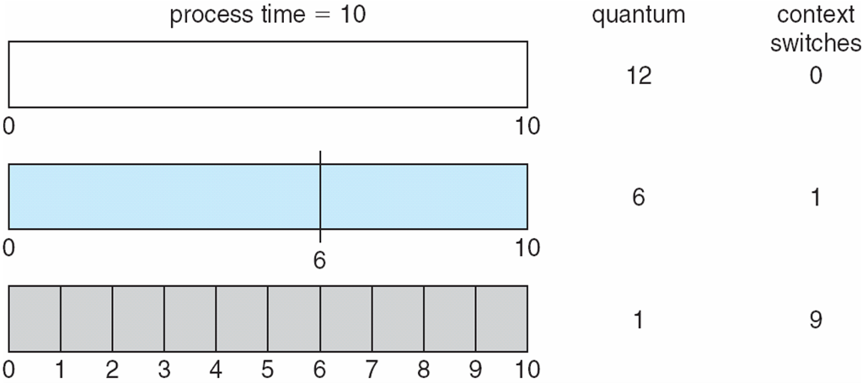
Time Quantum and Context Switch Time

Slide 115
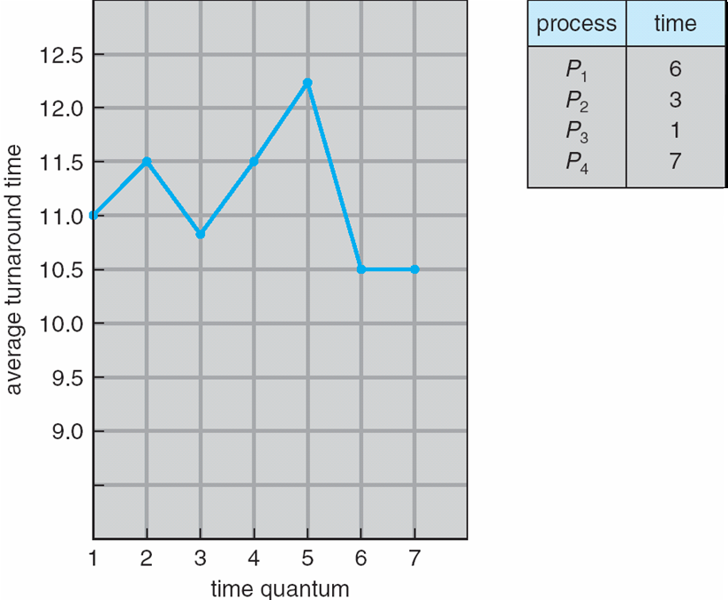
Turnaround Time Varies With The Time Quantum
80% of CPU bursts should be shorter than q

Slide 116
Multilevel Queue
Ready queue is partitioned into separate queues, eg:
foreground (interactive)
background (batch)
Process permanently in a given queue
Each queue has its own scheduling algorithm:
foreground – RR
background – FCFS
Scheduling must be done between the queues:
Fixed priority scheduling; (i.e., serve all from foreground then from background). Possibility of starvation.
Time slice – each queue gets a certain amount of CPU time which it can schedule amongst its processes; i.e., 80% to foreground in RR
20% to background in FCFS

Slide 117
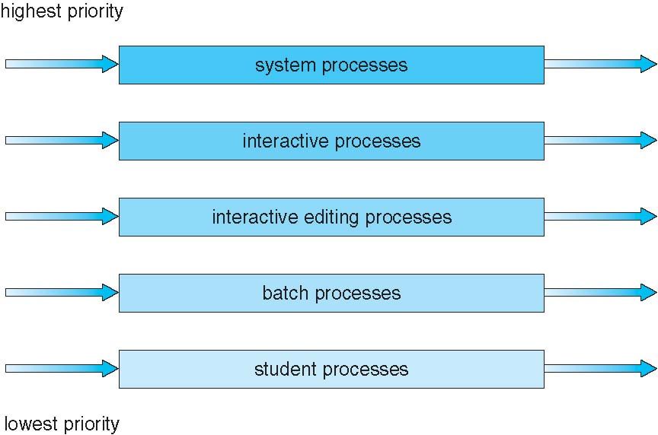
Multilevel Queue Scheduling

Slide 118
Chapter 5: Process Synchronization
Background
The Critical-Section Problem
Peterson’s Solution
Synchronization Hardware
Mutex Locks
Semaphores
Classic Problems of Synchronization
Monitors
Synchronization Examples
Alternative Approaches

Slide 119
Objectives
To present the concept of process synchronization.
To introduce the critical-section problem, whose solutions can be used to ensure the consistency of shared data
To present both software and hardware solutions of the critical-section problem
To examine several classical process-synchronization problems
To explore several tools that are used to solve process synchronization problems

Slide 120
Background
Processes can execute concurrently
May be interrupted at any time, partially completing execution
Concurrent access to shared data may result in data inconsistency
Maintaining data consistency requires mechanisms to ensure the orderly execution of cooperating processes
Illustration of the problem: Suppose that we wanted to provide a solution to the consumer-producer problem that fills all the buffers. We can do so by having an integer counter that keeps track of the number of full buffers. Initially, counter is set to 0. It is incremented by the producer after it produces a new buffer and is decremented by the consumer after it consumes a buffer.

Slide 121
Producer
while (true) { /* produce an item in next produced */
while (counter == BUFFER_SIZE) ;
/* do nothing */
buffer[in] = next_produced;
in = (in + 1) % BUFFER_SIZE;
counter++;
}

Slide 122
Consumer
while (true) {
while (counter == 0)
; /* do nothing */
next_consumed = buffer[out];
out = (out + 1) % BUFFER_SIZE;
counter--;
/* consume the item in next consumed */
}

Slide 123
Race Condition
counter++ could be implemented as register1 = counter register1 = register1 + 1 counter = register1
counter-- could be implemented as register2 = counter register2 = register2 - 1 counter = register2
Consider this execution interleaving with “count = 5” initially:
S0: producer execute register1 = counter {register1 = 5} S1: producer execute register1 = register1 + 1 {register1 = 6} S2: consumer execute register2 = counter {register2 = 5} S3: consumer execute register2 = register2 – 1 {register2 = 4} S4: producer execute counter = register1 {counter = 6 } S5: consumer execute counter = register2 {counter = 4}

Slide 124
Critical Section Problem
Consider system of n processes {p₀, p₁, … p_{n-1}}
Each process has critical section segment of code
Process may be changing common variables, updating table, writing file, etc
When one process in critical section, no other may be in its critical section
Critical section problem is to design protocol to solve this
Each process must ask permission to enter critical section in entry section, may follow critical section with exit section, then remainder section

Slide 125
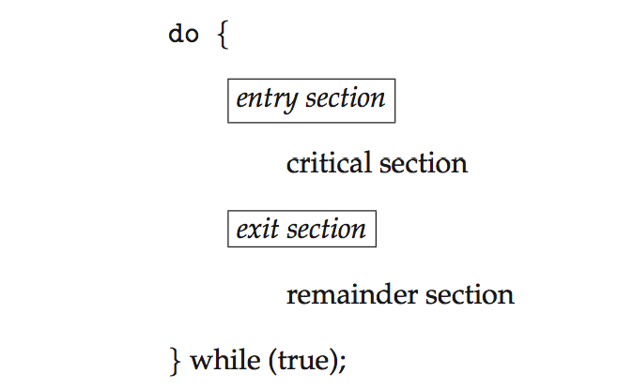
Critical Section
General structure of process P_{i}

Slide 126
Algorithm for Process P_{i}
do {
while (turn == j);
critical section
turn = j;
remainder section
} while (true);

Slide 127
Solution to Critical-Section Problem
1. Mutual Exclusion - If process P_{i} is executing in its critical section, then no other processes can be executing in their critical sections
2. Progress - If no process is executing in its critical section and there exist some processes that wish to enter their critical section, then the selection of the processes that will enter the critical section next cannot be postponed indefinitely
3. Bounded Waiting - A bound must exist on the number of times that other processes are allowed to enter their critical sections after a process has made a request to enter its critical section and before that request is granted
Assume that each process executes at a nonzero speed
No assumption concerning relative speed of the n processes

Slide 128
Critical-Section Handling in OS
Two approaches depending on if kernel is preemptive or non- preemptive
Preemptive – allows preemption of process when running in kernel mode
Non-preemptive – runs until exits kernel mode, blocks, or voluntarily yields CPU
Essentially free of race conditions in kernel mode

Slide 129
Peterson’s Solution
Good algorithmic description of solving the problem
Two process solution
Assume that the load and store machine-language instructions are atomic; that is, cannot be interrupted
The two processes share two variables:
int turn;
Boolean flag[2]
The variable turn indicates whose turn it is to enter the critical section
The flag array is used to indicate if a process is ready to enter the critical section. flag[i] = true implies that process P_{i} is ready!

Slide 130
Algorithm for Process P_{i}
do {
flag[i] = true;
turn = j;
while (flag[j] && turn = = j);
critical section
flag[i] = false;
remainder section
} while (true);

Slide 131
Peterson’s Solution (Cont.)
Provable that the three CS requirement are met:
1. Mutual exclusion is preserved
P_{i} enters CS only if:
either flag[j] = false or turn = i
2. Progress requirement is satisfied
3. Bounded-waiting requirement is met

Slide 132
Synchronization Hardware
Many systems provide hardware support for implementing the critical section code.
All solutions below based on idea of locking
Protecting critical regions via locks
Uniprocessors – could disable interrupts
Currently running code would execute without preemption
Generally too inefficient on multiprocessor systems
Operating systems using this not broadly scalable
Modern machines provide special atomic hardware instructions
Atomic = non-interruptible
Either test memory word and set value
Or swap contents of two memory words

Slide 133
Solution to Critical-section Problem Using Locks
do {
acquire lock
critical section
release lock
remainder section
} while (TRUE);

Slide 134
test_and_set Instruction
Definition:
boolean test_and_set (boolean *target)
{
boolean rv = *target;
*target = TRUE;
return rv:
}
Executed atomically
Returns the original value of passed parameter
Set the new value of passed parameter to “TRUE”.

Slide 135
Solution using test_and_set()
Shared Boolean variable lock, initialized to FALSE
Solution:
do { while (test_and_set(&lock))
; /* do nothing */
/* critical section */
lock = false;
/* remainder section */
} while (true);

Slide 136
compare_and_swap Instruction
Definition:
int compare _and_swap(int *value, int expected, int new_value) {
int temp = *value;
if (*value == expected)
*value = new_value;
return temp;
}
Executed atomically
Returns the original value of passed parameter “value”
Set the variable “value” the value of the passed parameter “new_value” but only if “value” ==“expected”. That is, the swap takes place only under this condition.

Slide 137
Solution using compare_and_swap
Shared integer “lock” initialized to 0;
Solution:
do { while (compare_and_swap(&lock, 0, 1) != 0)
; /* do nothing */
/* critical section */
lock = 0;
/* remainder section */
} while (true);

Slide 138
Bounded-waiting Mutual Exclusion with test_and_set
do { waiting[i] = true; key = true; while (waiting[i] && key)
key = test_and_set(&lock);
waiting[i] = false;
/* critical section */
j = (i + 1) % n;
while ((j != i) && !waiting[j])
j = (j + 1) % n;
if (j == i)
lock = false;
else
waiting[j] = false;
/* remainder section */
} while (true);

Slide 139
Mutex Locks
Previous solutions are complicated and generally inaccessible to application programmers
OS designers build software tools to solve critical section problem
Simplest is mutex lock
Protect a critical section by first acquire() a lock then release() the lock
Boolean variable indicating if lock is available or not
Calls to acquire() and release() must be atomic
Usually implemented via hardware atomic instructions
But this solution requires busy waiting
This lock therefore called a spinlock

Slide 140
acquire() and release()
acquire() { while (!available)
; /* busy wait */
available = false;;
}
release() {
available = true;
}
do {
acquire lock
critical section
release lock
remainder section
} while (true);

Slide 141
Semaphore
Synchronization tool that provides more sophisticated ways (than Mutex locks) for process to synchronize their activities.
Semaphore S – integer variable
Can only be accessed via two indivisible (atomic) operations
wait() and signal()
Originally called P() and V()
Definition of the wait() operation
wait(S) {
while (S <= 0)
; // busy wait
S--;
}
Definition of the signal() operation
signal(S) {
S++;
}

Slide 142
Semaphore Usage
Counting semaphore – integer value can range over an unrestricted domain
Binary semaphore – integer value can range only between 0 and 1
Same as a mutex lock
Can solve various synchronization problems
Consider P₁ and P₂ that require S₁ to happen before S₂
Create a semaphore “synch” initialized to 0
P1:
S₁;
signal(synch);
P2:
wait(synch);
S₂;
Can implement a counting semaphore S as a binary semaphore

Slide 143
Semaphore Implementation
Must guarantee that no two processes can execute the wait() and signal() on the same semaphore at the same time
Thus, the implementation becomes the critical section problem where the wait and signal code are placed in the critical section
Could now have busy waiting in critical section implementation
But implementation code is short
Little busy waiting if critical section rarely occupied
Note that applications may spend lots of time in critical sections and therefore this is not a good solution

Slide 144
Semaphore Implementation with no Busy waiting
With each semaphore there is an associated waiting queue
Each entry in a waiting queue has two data items:
value (of type integer)
pointer to next record in the list
Two operations:
block – place the process invoking the operation on the appropriate waiting queue
wakeup – remove one of processes in the waiting queue and place it in the ready queue
typedef struct{
int value;
struct process *list;
} semaphore;

Slide 145
Implementation with no Busy waiting (Cont.)
wait(semaphore *S) {
S->value--;
if (S->value < 0) { add this process to S->list;
block();
}
}
signal(semaphore *S) {
S->value++;
if (S->value <= 0) { remove a process P from S->list;
wakeup(P);
}
}

Slide 146
Deadlock and Starvation
Deadlock – two or more processes are waiting indefinitely for an event that can be caused by only one of the waiting processes
Let S and Q be two semaphores initialized to 1
P₀ P₁
wait(S); wait(Q);
wait(Q); wait(S);
... ...
signal(S); signal(Q);
signal(Q); signal(S);
Starvation – indefinite blocking
A process may never be removed from the semaphore queue in which it is suspended
Priority Inversion – Scheduling problem when lower-priority process holds a lock needed by higher-priority process
Solved via priority-inheritance protocol

Slide 147
Classical Problems of Synchronization
Classical problems used to test newly-proposed synchronization schemes
Bounded-Buffer Problem
Readers and Writers Problem
Dining-Philosophers Problem

Slide 148
Bounded-Buffer Problem
n buffers, each can hold one item
Semaphore mutex initialized to the value 1
Semaphore full initialized to the value 0
Semaphore empty initialized to the value n

Slide 149
Bounded Buffer Problem (Cont.)
The structure of the producer process
do {
... /* produce an item in next_produced */
...
wait(empty);
wait(mutex);
... /* add next produced to the buffer */
...
signal(mutex);
signal(full);
} while (true);

Slide 150
Bounded Buffer Problem (Cont.)
The structure of the consumer process
Do {
wait(full);
wait(mutex);
... /* remove an item from buffer to next_consumed */
...
signal(mutex);
signal(empty);
... /* consume the item in next consumed */
... } while (true);

Slide 151
Readers-Writers Problem
A data set is shared among a number of concurrent processes
Readers – only read the data set; they do not perform any updates
Writers – can both read and write
Problem – allow multiple readers to read at the same time
Only one single writer can access the shared data at the same time
Several variations of how readers and writers are considered – all involve some form of priorities
Shared Data
Data set
Semaphore rw_mutex initialized to 1
Semaphore mutex initialized to 1
Integer read_count initialized to 0

Slide 152
Readers-Writers Problem (Cont.)
The structure of a writer process
do { wait(rw_mutex);
... /* writing is performed */
...
signal(rw_mutex);
} while (true);

Slide 153
Readers-Writers Problem (Cont.)
The structure of a reader process
do { wait(mutex); read_count++; if (read_count == 1)
wait(rw_mutex);
signal(mutex);
... /* reading is performed */
...
wait(mutex); read count--; if (read_count == 0)
signal(rw_mutex);
signal(mutex);
} while (true);

Slide 154
Readers-Writers Problem Variations
First variation – no reader kept waiting unless writer has permission to use shared object
Second variation – once writer is ready, it performs the write ASAP
Both may have starvation leading to even more variations
Problem is solved on some systems by kernel providing reader-writer locks

Slide 155
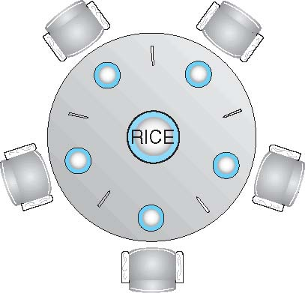
Dining-Philosophers Problem
Philosophers spend their lives alternating thinking and eating
Don’t interact with their neighbors, occasionally try to pick up 2 chopsticks (one at a time) to eat from bowl
Need both to eat, then release both when done
In the case of 5 philosophers
Shared data
Bowl of rice (data set)
Semaphore chopstick [5] initialized to 1

Slide 156
Dining-Philosophers Problem Algorithm
The structure of Philosopher i:
do {
wait (chopstick[i] );
wait (chopStick[ (i + 1) % 5] );
// eat
signal (chopstick[i] );
signal (chopstick[ (i + 1) % 5] );
// think
} while (TRUE);
What is the problem with this algorithm?

Slide 157
Dining-Philosophers Problem Algorithm (Cont.)
Deadlock handling
Allow at most 4 philosophers to be sitting simultaneously at the table.
Allow a philosopher to pick up the forks only if both are available (picking must be done in a critical section.
Use an asymmetric solution -- an odd-numbered philosopher picks up first the left chopstick and then the right chopstick. Even-numbered philosopher picks up first the right chopstick and then the left chopstick.

Slide 158
Problems with Semaphores
Incorrect use of semaphore operations:
signal (mutex) …. wait (mutex)
wait (mutex) … wait (mutex)
Omitting of wait (mutex) or signal (mutex) (or both)
Deadlock and starvation are possible.

Slide 159
Monitors
A high-level abstraction that provides a convenient and effective mechanism for process synchronization
Abstract data type, internal variables only accessible by code within the procedure
Only one process may be active within the monitor at a time
But not powerful enough to model some synchronization schemes
monitor monitor-name
{
// shared variable declarations
procedure P1 (…) { …. }
procedure Pn (…) {……}
Initialization code (…) { … }
}
}

Slide 160
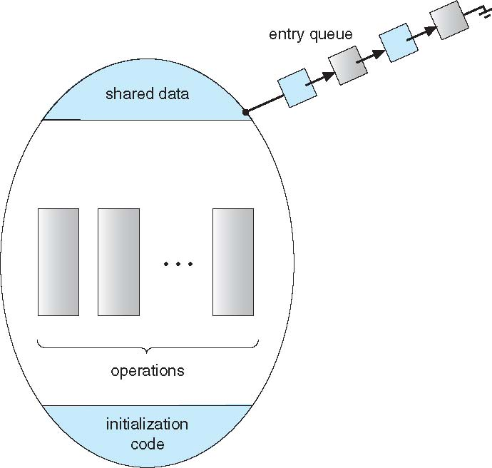
Schematic view of a Monitor

Slide 161
Condition Variables
condition x, y;
Two operations are allowed on a condition variable:
x.wait() – a process that invokes the operation is suspended until x.signal()
x.signal() – resumes one of processes (if any) that invoked x.wait()
If no x.wait() on the variable, then it has no effect on the variable

Slide 162
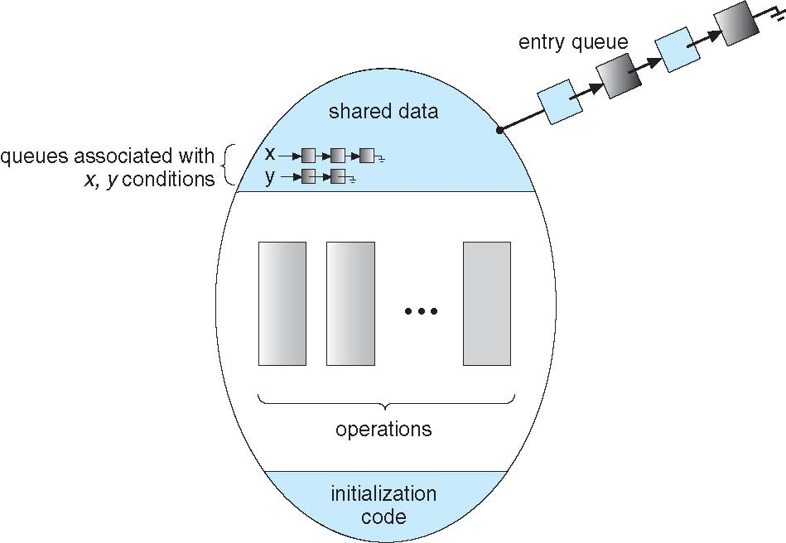
Monitor with Condition Variables

Slide 163
Condition Variables Choices
If process P invokes x.signal(), and process Q is suspended in x.wait(), what should happen next?
Both Q and P cannot execute in paralel. If Q is resumed, then P must wait
Options include
Signal and wait – P waits until Q either leaves the monitor or it waits for another condition
Signal and continue – Q waits until P either leaves the monitor or it waits for another condition
Both have pros and cons – language implementer can decide
Monitors implemented in Concurrent Pascal compromise
P executing signal immediately leaves the monitor, Q is resumed
Implemented in other languages including Mesa, C#, Java

Slide 164
Monitor Solution to Dining Philosophers
monitor DiningPhilosophers
{
enum { THINKING; HUNGRY, EATING) state [5] ;
condition self [5];
void pickup (int i) {
state[i] = HUNGRY;
test(i);
if (state[i] != EATING) self[i].wait;
}
void putdown (int i) {
state[i] = THINKING;
// test left and right neighbors
test((i + 4) % 5);
test((i + 1) % 5);
}

Slide 165
Solution to Dining Philosophers (Cont.)
void test (int i) {
if ((state[(i + 4) % 5] != EATING) &&
(state[i] == HUNGRY) &&
(state[(i + 1) % 5] != EATING) ) {
state[i] = EATING ;
self[i].signal () ;
}
}
initialization_code() {
for (int i = 0; i < 5; i++)
state[i] = THINKING;
}
}

Slide 166
Solution to Dining Philosophers (Cont.)
Each philosopher i invokes the operations pickup() and putdown() in the following sequence:
DiningPhilosophers.pickup(i);
EAT
DiningPhilosophers.putdown(i);
No deadlock, but starvation is possible

Slide 167
Monitor Implementation Using Semaphores
Variables
semaphore mutex; // (initially = 1)
semaphore next; // (initially = 0)
int next_count = 0;
Each procedure F will be replaced by
wait(mutex);
…
body of F;
…
if (next_count > 0)
signal(next)
else
signal(mutex);
Mutual exclusion within a monitor is ensured

Slide 168
Monitor Implementation – Condition Variables
For each condition variable x, we have:
semaphore x_sem; // (initially = 0)
int x_count = 0;
The operation x.wait can be implemented as:
x_count++;
if (next_count > 0)
signal(next);
else
signal(mutex);
wait(x_sem);
x_count--;

Slide 169
Monitor Implementation (Cont.)
The operation x.signal can be implemented as:
if (x_count > 0) {
next_count++;
signal(x_sem);
wait(next);
next_count--;
}

Slide 170
Chapter 8: Memory Management
Background
Swapping
Contiguous Memory Allocation
Segmentation
Paging
Structure of the Page Table
Example: The Intel 32 and 64-bit Architectures
Example: ARM Architecture

Slide 171
Objectives
To provide a detailed description of various ways of organizing memory hardware
To discuss various memory-management techniques, including paging and segmentation
To provide a detailed description of the Intel Pentium, which supports both pure segmentation and segmentation with paging

Slide 172
Background
Program must be brought (from disk) into memory and placed within a process for it to be run
Main memory and registers are only storage CPU can access directly
Memory unit only sees a stream of addresses + read requests, or address + data and write requests
Register access in one CPU clock (or less)
Main memory can take many cycles, causing a stall
Cache sits between main memory and CPU registers
Protection of memory required to ensure correct operation

Slide 173
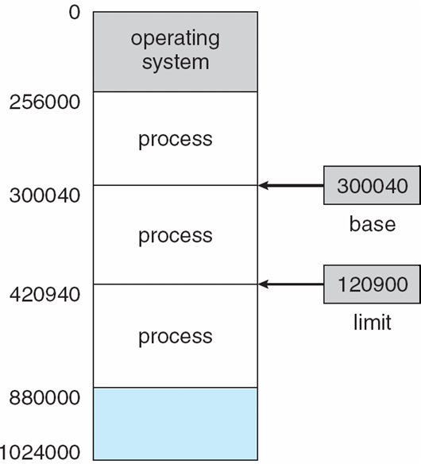
Base and Limit Registers
A pair of base and limit registers define the logical address space
CPU must check every memory access generated in user mode to be sure it is between base and limit for that user

Slide 174
Hardware Address Protection

Slide 175
Address Binding
Programs on disk, ready to be brought into memory to execute form an input queue
Without support, must be loaded into address 0000
Inconvenient to have first user process physical address always at 0000
How can it not be?
Further, addresses represented in different ways at different stages of a program’s life
Source code addresses usually symbolic
Compiled code addresses bind to relocatable addresses
i.e. “14 bytes from beginning of this module”
Linker or loader will bind relocatable addresses to absolute addresses
i.e. 74014
Each binding maps one address space to another

Slide 176
Binding of Instructions and Data to Memory
Address binding of instructions and data to memory addresses can happen at three different stages
Compile time: If memory location known a priori, absolute code can be generated; must recompile code if starting location changes
Load time: Must generate relocatable code if memory location is not known at compile time
Execution time: Binding delayed until run time if the process can be moved during its execution from one memory segment to another
Need hardware support for address maps (e.g., base and limit registers)

Slide 177
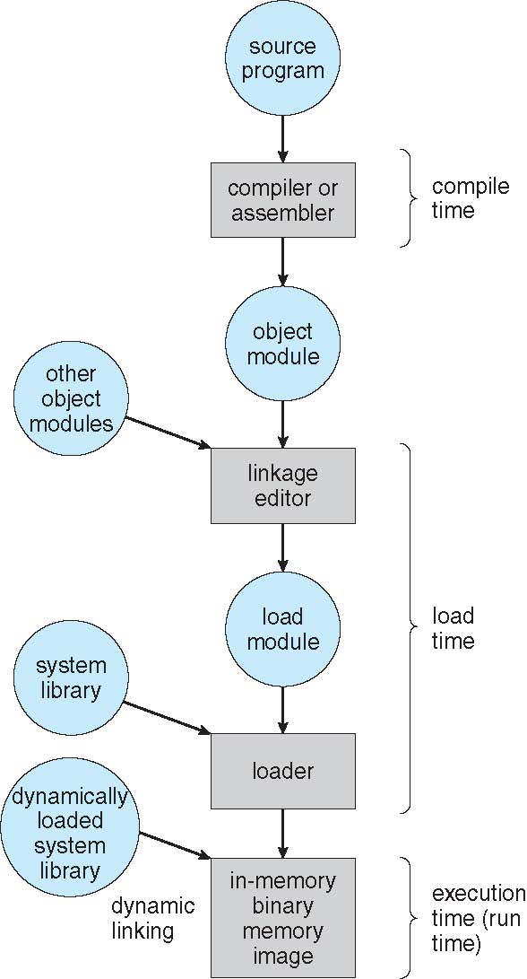
Multistep Processing of a User Program

Slide 178
Logical vs. Physical Address Space
The concept of a logical address space that is bound to a separate physical address space is central to proper memory management
Logical address – generated by the CPU; also referred to as virtual address
Physical address – address seen by the memory unit
Logical and physical addresses are the same in compile-time and load-time address-binding schemes; logical (virtual) and physical addresses differ in execution-time address-binding scheme
Logical address space is the set of all logical addresses generated by a program
Physical address space is the set of all physical addresses generated by a program

Slide 179
Memory-Management Unit (MMU)
Hardware device that at run time maps virtual to physical address
Many methods possible, covered in the rest of this chapter
To start, consider simple scheme where the value in the relocation register is added to every address generated by a user process at the time it is sent to memory
Base register now called relocation register
MS-DOS on Intel 80x86 used 4 relocation registers
The user program deals with logical addresses; it never sees the real physical addresses
Execution-time binding occurs when reference is made to location in memory
Logical address bound to physical addresses

Slide 180
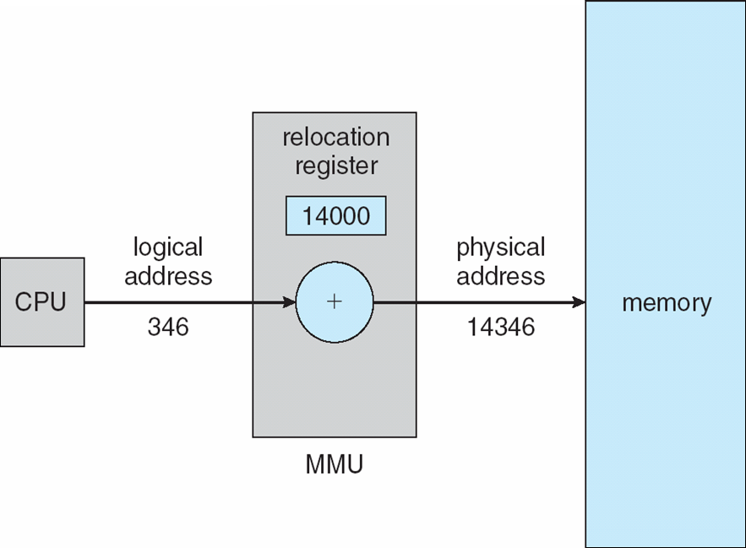
Dynamic relocation using a relocation register
Routine is not loaded until it is called
Better memory-space utilization; unused routine is never loaded
All routines kept on disk in relocatable load format
Useful when large amounts of code are needed to handle infrequently occurring cases
No special support from the operating system is required
Implemented through program design
OS can help by providing libraries to implement dynamic loading

Slide 181
Dynamic Linking
Static linking – system libraries and program code combined by the loader into the binary program image
Dynamic linking –linking postponed until execution time
Small piece of code, stub, used to locate the appropriate memory-resident library routine
Stub replaces itself with the address of the routine, and executes the routine
Operating system checks if routine is in processes’ memory address
If not in address space, add to address space
Dynamic linking is particularly useful for libraries
System also known as shared libraries
Consider applicability to patching system libraries
Versioning may be needed

Slide 182
Swapping
A process can be swapped temporarily out of memory to a backing store, and then brought back into memory for continued execution
Total physical memory space of processes can exceed physical memory
Backing store – fast disk large enough to accommodate copies of all memory images for all users; must provide direct access to these memory images
Roll out, roll in – swapping variant used for priority-based scheduling algorithms; lower-priority process is swapped out so higher-priority process can be loaded and executed
Major part of swap time is transfer time; total transfer time is directly proportional to the amount of memory swapped
System maintains a ready queue of ready-to-run processes which have memory images on disk

Slide 183
Swapping (Cont.)
Does the swapped out process need to swap back in to same physical addresses?
Depends on address binding method
Plus consider pending I/O to / from process memory space
Modified versions of swapping are found on many systems (i.e., UNIX, Linux, and Windows)
Swapping normally disabled
Started if more than threshold amount of memory allocated
Disabled again once memory demand reduced below threshold

Slide 184

Schematic View of Swapping

Slide 185
Context Switch Time including Swapping
If next processes to be put on CPU is not in memory, need to swap out a process and swap in target process
Context switch time can then be very high
100MB process swapping to hard disk with transfer rate of 50MB/sec
Swap out time of 2000 ms
Plus swap in of same sized process
Total context switch swapping component time of 4000ms (4 seconds)
Can reduce if reduce size of memory swapped – by knowing how much memory really being used
System calls to inform OS of memory use via request_memory() and release_memory()

Slide 186
Context Switch Time and Swapping (Cont.)
Other constraints as well on swapping
Pending I/O – can’t swap out as I/O would occur to wrong process
Or always transfer I/O to kernel space, then to I/O device
Known as double buffering, adds overhead
Standard swapping not used in modern operating systems
But modified version common
Swap only when free memory extremely low

Slide 187
Swapping on Mobile Systems
Not typically supported
Flash memory based
Small amount of space
Limited number of write cycles
Poor throughput between flash memory and CPU on mobile platform
Instead use other methods to free memory if low
iOS asks apps to voluntarily relinquish allocated memory
Read-only data thrown out and reloaded from flash if needed
Failure to free can result in termination
Android terminates apps if low free memory, but first writes application state to flash for fast restart
Both OSes support paging as discussed below

Slide 188
Contiguous Allocation
Main memory must support both OS and user processes
Limited resource, must allocate efficiently
Contiguous allocation is one early method
Main memory usually into two partitions:
Resident operating system, usually held in low memory with interrupt vector
User processes then held in high memory
Each process contained in single contiguous section of memory

Slide 189
Contiguous Allocation (Cont.)
Relocation registers used to protect user processes from each other, and from changing operating-system code and data
Base register contains value of smallest physical address
Limit register contains range of logical addresses – each logical address must be less than the limit register
MMU maps logical address dynamically
Can then allow actions such as kernel code being transient and kernel changing size

Slide 190

Hardware Support for Relocation and Limit Registers

Slide 191
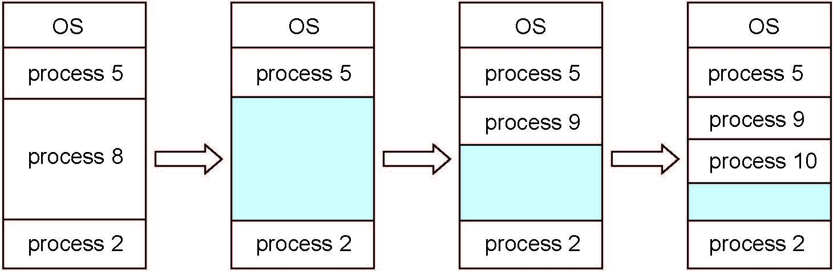
Multiple-partition allocation
Multiple-partition allocation
Degree of multiprogramming limited by number of partitions
Variable-partition sizes for efficiency (sized to a given process’ needs)
Hole – block of available memory; holes of various size are scattered throughout memory
When a process arrives, it is allocated memory from a hole large enough to accommodate it
Process exiting frees its partition, adjacent free partitions combined
Operating system maintains information about: a) allocated partitions b) free partitions (hole)

Slide 192
Dynamic Storage-Allocation Problem
How to satisfy a request of size n from a list of free holes?
First-fit: Allocate the first hole that is big enough
Best-fit: Allocate the smallest hole that is big enough; must search entire list, unless ordered by size
Produces the smallest leftover hole
Worst-fit: Allocate the largest hole; must also search entire list
Produces the largest leftover hole
First-fit and best-fit better than worst-fit in terms of speed and storage utilization

Slide 193
Fragmentation
External Fragmentation – total memory space exists to satisfy a request, but it is not contiguous
Internal Fragmentation – allocated memory may be slightly larger than requested memory; this size difference is memory internal to a partition, but not being used
First fit analysis reveals that given N blocks allocated, 0.5 N blocks lost to fragmentation
1/3 may be unusable -> 50-percent rule

Slide 194
Fragmentation (Cont.)
Reduce external fragmentation by compaction
Shuffle memory contents to place all free memory together in one large block
Compaction is possible only if relocation is dynamic, and is done at execution time
I/O problem
Latch job in memory while it is involved in I/O
Do I/O only into OS buffers
Now consider that backing store has same fragmentation problems

Slide 195
Segmentation
Memory-management scheme that supports user view of memory
A program is a collection of segments
A segment is a logical unit such as:
main program
procedure
function
method
object
local variables, global variables
common block
stack
symbol table
arrays

Slide 196
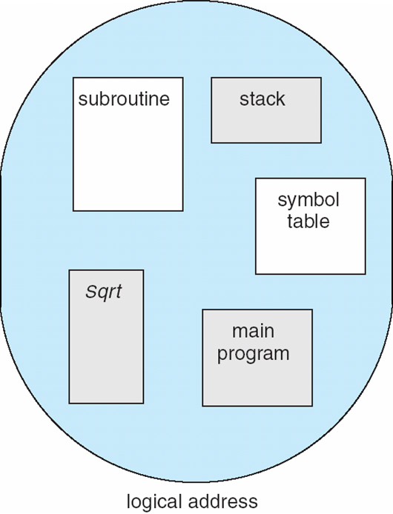
User’s View of a Program

Slide 197
Logical View of Segmentation
1
1
4
2
3
4
2
3
user space
physical memory space

Slide 198
Segmentation Architecture
Logical address consists of a two tuple:
<segment-number, offset>,
Segment table – maps two-dimensional physical addresses; each table entry has:
base – contains the starting physical address where the segments reside in memory
limit – specifies the length of the segment
Segment-table base register (STBR) points to the segment table’s location in memory
Segment-table length register (STLR) indicates number of segments used by a program;
segment number s is legal if s < STLR

Slide 199
Segmentation Architecture (Cont.)
Protection
With each entry in segment table associate:
validation bit = 0 ⇒ illegal segment
read/write/execute privileges
Protection bits associated with segments; code sharing occurs at segment level
Since segments vary in length, memory allocation is a dynamic storage-allocation problem
A segmentation example is shown in the following diagram

Slide 200
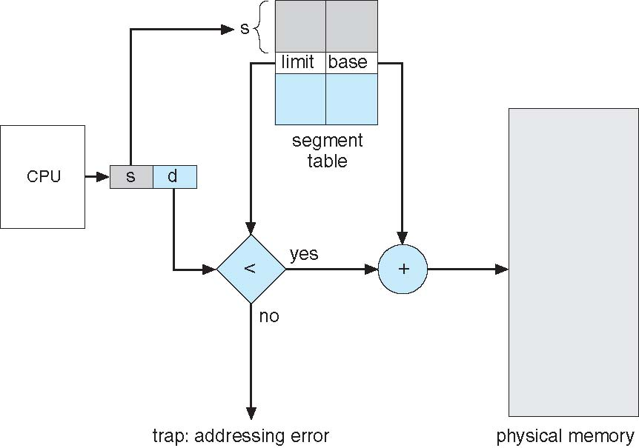
Segmentation Hardware

Slide 201
Paging
Physical address space of a process can be noncontiguous; process is allocated physical memory whenever the latter is available
Avoids external fragmentation
Avoids problem of varying sized memory chunks
Divide physical memory into fixed-sized blocks called frames
Size is power of 2, between 512 bytes and 16 Mbytes
Divide logical memory into blocks of same size called pages
Keep track of all free frames
To run a program of size N pages, need to find N free frames and load program
Set up a page table to translate logical to physical addresses
Backing store likewise split into pages
Still have Internal fragmentation

Slide 202
Address Translation Scheme
Address generated by CPU is divided into:
Page number (p) – used as an index into a page table which contains base address of each page in physical memory
Page offset (d) – combined with base address to define the physical memory address that is sent to the memory unit
For given logical address space 2^{m} and page size 2^{n}

Slide 203
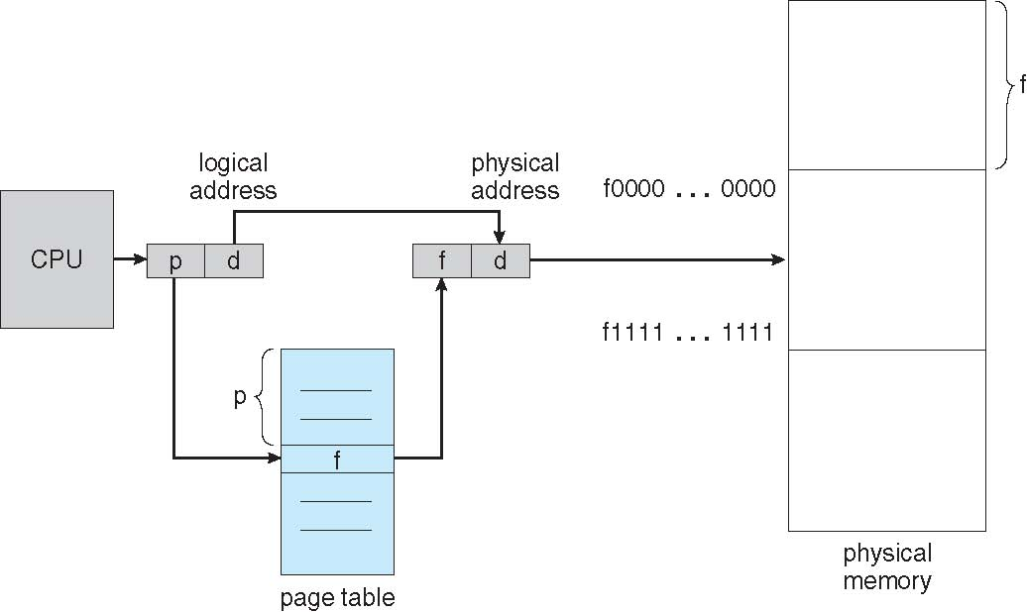
Paging Hardware

Slide 204

Paging Model of Logical and Physical Memory

Slide 205

Paging Example
n=2 and m=4 32-byte memory and 4-byte pages

Slide 206
Paging (Cont.)
Calculating internal fragmentation
Page size = 2,048 bytes
Process size = 72,766 bytes
35 pages + 1,086 bytes
Internal fragmentation of 2,048 - 1,086 = 962 bytes
Worst case fragmentation = 1 frame – 1 byte
On average fragmentation = 1 / 2 frame size
So small frame sizes desirable?
But each page table entry takes memory to track
Page sizes growing over time
Solaris supports two page sizes – 8 KB and 4 MB
Process view and physical memory now very different
By implementation process can only access its own memory

Slide 207

Free Frames
Before allocation
After allocation

Slide 208
Implementation of Page Table
Page table is kept in main memory
Page-table base register (PTBR) points to the page table
Page-table length register (PTLR) indicates size of the page table
In this scheme every data/instruction access requires two memory accesses
One for the page table and one for the data / instruction
The two memory access problem can be solved by the use of a special fast-lookup hardware cache called associative memory or translation look-aside buffers (TLBs)

Slide 209
Implementation of Page Table (Cont.)
Some TLBs store address-space identifiers (ASIDs) in each TLB entry – uniquely identifies each process to provide address-space protection for that process
Otherwise need to flush at every context switch
TLBs typically small (64 to 1,024 entries)
On a TLB miss, value is loaded into the TLB for faster access next time
Replacement policies must be considered
Some entries can be wired down for permanent fast access

Slide 210
Associative Memory
Associative memory – parallel search
Address translation (p, d)
If p is in associative register, get frame # out
Otherwise get frame # from page table in memory

Slide 211

Paging Hardware With TLB

Slide 212
Effective Access Time
Associative Lookup = ε time unit
Can be < 10% of memory access time
Hit ratio = α
Hit ratio – percentage of times that a page number is found in the associative registers; ratio related to number of associative registers
Consider α = 80%, ε = 20ns for TLB search, 100ns for memory access
Effective Access Time (EAT)
EAT = (1 + ε) α + (2 + ε)(1 – α)
= 2 + ε – α
Consider α = 80%, ε = 20ns for TLB search, 100ns for memory access
EAT = 0.80 x 100 + 0.20 x 200 = 120ns
Consider more realistic hit ratio -> α = 99%, ε = 20ns for TLB search, 100ns for memory access
EAT = 0.99 x 100 + 0.01 x 200 = 101ns

Slide 213
Memory Protection
Memory protection implemented by associating protection bit with each frame to indicate if read-only or read-write access is allowed
Can also add more bits to indicate page execute-only, and so on
Valid-invalid bit attached to each entry in the page table:
“valid” indicates that the associated page is in the process’ logical address space, and is thus a legal page
“invalid” indicates that the page is not in the process’ logical address space
Or use page-table length register (PTLR)
Any violations result in a trap to the kernel

Slide 214

Valid (v) or Invalid (i) Bit In A Page Table

Slide 215
Shared Pages
Shared code
One copy of read-only (reentrant) code shared among processes (i.e., text editors, compilers, window systems)
Similar to multiple threads sharing the same process space
Also useful for interprocess communication if sharing of read-write pages is allowed
Private code and data
Each process keeps a separate copy of the code and data
The pages for the private code and data can appear anywhere in the logical address space

Slide 216
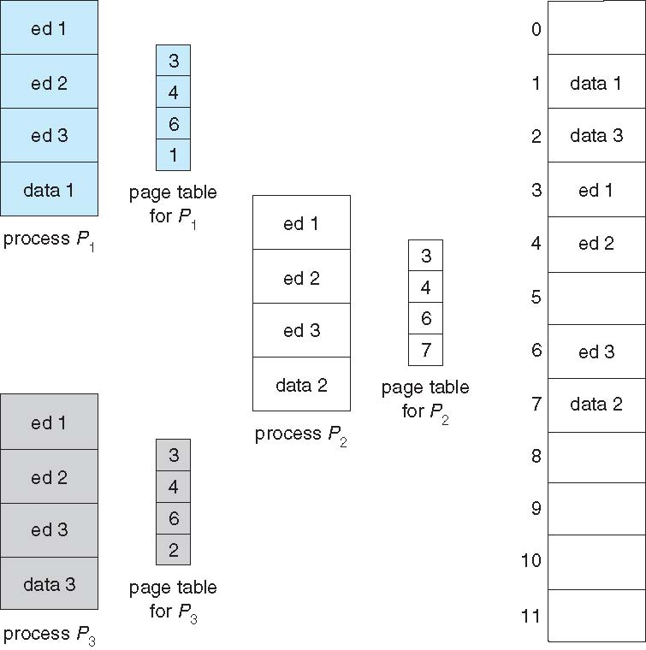
Shared Pages Example

Slide 217
Structure of the Page Table
Memory structures for paging can get huge using straight-forward methods
Consider a 32-bit logical address space as on modern computers
Page size of 4 KB (2¹²)
Page table would have 1 million entries (2³² / 2¹²)
If each entry is 4 bytes -> 4 MB of physical address space / memory for page table alone
That amount of memory used to cost a lot
Don’t want to allocate that contiguously in main memory
Hierarchical Paging
Hashed Page Tables
Inverted Page Tables

Slide 218
Hierarchical Page Tables
Break up the logical address space into multiple page tables
A simple technique is a two-level page table
We then page the page table

Slide 219

Two-Level Page-Table Scheme

Slide 220
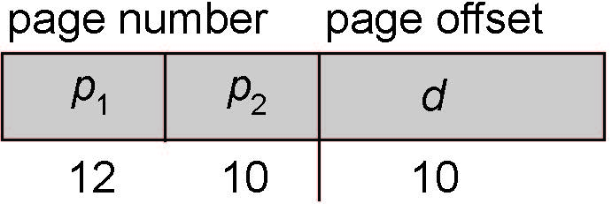
Two-Level Paging Example
A logical address (on 32-bit machine with 1K page size) is divided into:
a page number consisting of 22 bits
a page offset consisting of 10 bits
Since the page table is paged, the page number is further divided into:
a 12-bit page number
a 10-bit page offset
Thus, a logical address is as follows:
where p₁ is an index into the outer page table, and p₂ is the displacement within the page of the inner page table
Known as forward-mapped page table

Slide 221

Address-Translation Scheme

Slide 222
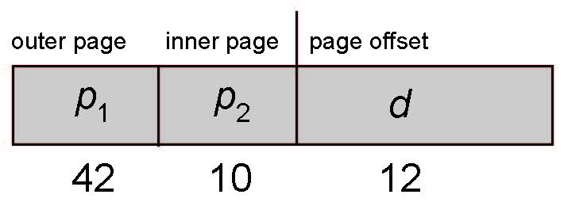
64-bit Logical Address Space
Even two-level paging scheme not sufficient
If page size is 4 KB (2¹²)
Then page table has 2⁵² entries
If two level scheme, inner page tables could be 2¹⁰ 4-byte entries
Address would look like
Outer page table has 2⁴² entries or 2⁴⁴ bytes
One solution is to add a 2nd outer page table
But in the following example the 2nd outer page table is still 2³⁴ bytes in size
And possibly 4 memory access to get to one physical memory location

Slide 223


Three-level Paging Scheme

Slide 224
Hashed Page Tables
Common in address spaces > 32 bits
The virtual page number is hashed into a page table
This page table contains a chain of elements hashing to the same location
Each element contains (1) the virtual page number (2) the value of the mapped page frame (3) a pointer to the next element
Virtual page numbers are compared in this chain searching for a match
If a match is found, the corresponding physical frame is extracted
Variation for 64-bit addresses is clustered page tables
Similar to hashed but each entry refers to several pages (such as 16) rather than 1
Especially useful for sparse address spaces (where memory references are non-contiguous and scattered)

Slide 225

Hashed Page Table

Slide 226
Inverted Page Table
Rather than each process having a page table and keeping track of all possible logical pages, track all physical pages
One entry for each real page of memory
Entry consists of the virtual address of the page stored in that real memory location, with information about the process that owns that page
Decreases memory needed to store each page table, but increases time needed to search the table when a page reference occurs
Use hash table to limit the search to one — or at most a few — page-table entries
TLB can accelerate access
But how to implement shared memory?
One mapping of a virtual address to the shared physical address

Slide 227

Inverted Page Table Architecture

Slide 228
Chapter 9: Virtual Memory
Background
Demand Paging
Copy-on-Write
Page Replacement
Allocation of Frames
Thrashing
Memory-Mapped Files
Allocating Kernel Memory
Other Considerations
Operating-System Examples

Slide 229
Objectives
To describe the benefits of a virtual memory system
To explain the concepts of demand paging, page-replacement algorithms, and allocation of page frames
To discuss the principle of the working-set model
To examine the relationship between shared memory and memory-mapped files
To explore how kernel memory is managed

Slide 230
Background
Code needs to be in memory to execute, but entire program rarely used
Error code, unusual routines, large data structures
Entire program code not needed at same time
Consider ability to execute partially-loaded program
Program no longer constrained by limits of physical memory
Each program takes less memory while running -> more programs run at the same time
Increased CPU utilization and throughput with no increase in response time or turnaround time
Less I/O needed to load or swap programs into memory -> each user program runs faster

Slide 231
Background (Cont.)
Virtual memory – separation of user logical memory from physical memory
Only part of the program needs to be in memory for execution
Logical address space can therefore be much larger than physical address space
Allows address spaces to be shared by several processes
Allows for more efficient process creation
More programs running concurrently
Less I/O needed to load or swap processes

Slide 232
Background (Cont.)
Virtual address space – logical view of how process is stored in memory
Usually start at address 0, contiguous addresses until end of space
Meanwhile, physical memory organized in page frames
MMU must map logical to physical
Virtual memory can be implemented via:
Demand paging
Demand segmentation

Slide 233
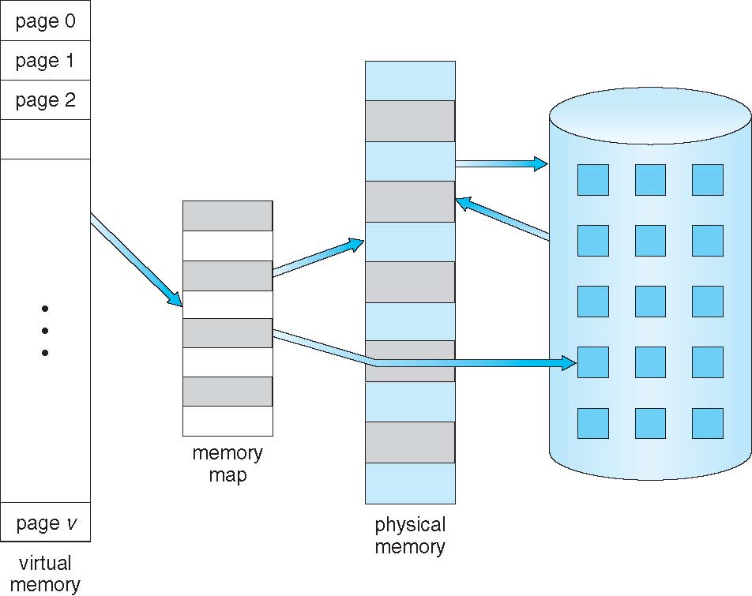
Virtual Memory That is Larger Than Physical Memory

Slide 234
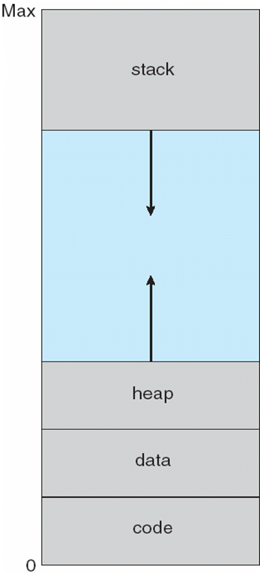
Virtual-address Space
Usually design logical address space for stack to start at Max logical address and grow “down” while heap grows “up”
Maximizes address space use
Unused address space between the two is hole
No physical memory needed until heap or stack grows to a given new page
Enables sparse address spaces with holes left for growth, dynamically linked libraries, etc
System libraries shared via mapping into virtual address space
Shared memory by mapping pages read-write into virtual address space
Pages can be shared during fork(), speeding process creation

Slide 235
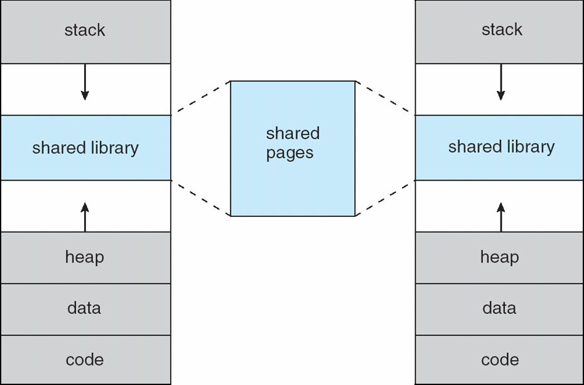
Shared Library Using Virtual Memory

Slide 236
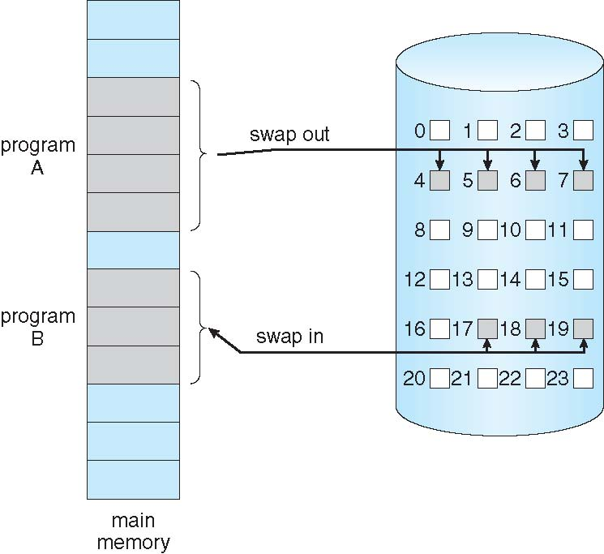
Demand Paging
Could bring entire process into memory at load time
Or bring a page into memory only when it is needed
Less I/O needed, no unnecessary I/O
Less memory needed
Faster response
More users
Similar to paging system with swapping (diagram on right)
Page is needed ⇒ reference to it
invalid reference ⇒ abort
not-in-memory ⇒ bring to memory
Lazy swapper – never swaps a page into memory unless page will be needed
Swapper that deals with pages is a pager

Slide 237
Basic Concepts
With swapping, pager guesses which pages will be used before swapping out again
Instead, pager brings in only those pages into memory
How to determine that set of pages?
Need new MMU functionality to implement demand paging
If pages needed are already memory resident
No difference from non demand-paging
If page needed and not memory resident
Need to detect and load the page into memory from storage
Without changing program behavior
Without programmer needing to change code

Slide 238
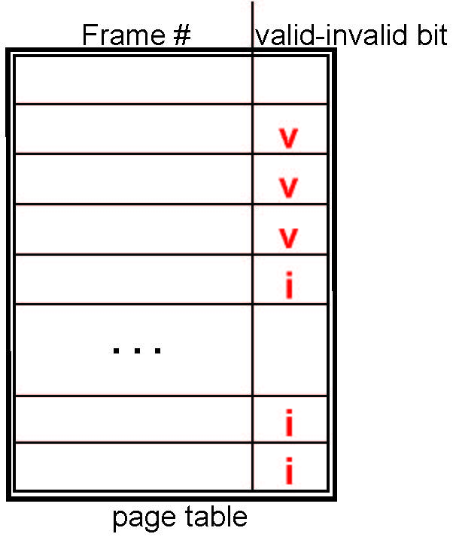
Valid-Invalid Bit
With each page table entry a valid–invalid bit is associated (v ⇒ in-memory – memory resident, i ⇒ not-in-memory)
Initially valid–invalid bit is set to i on all entries
Example of a page table snapshot:
During MMU address translation, if valid–invalid bit in page table entry is i ⇒ page fault

Slide 239
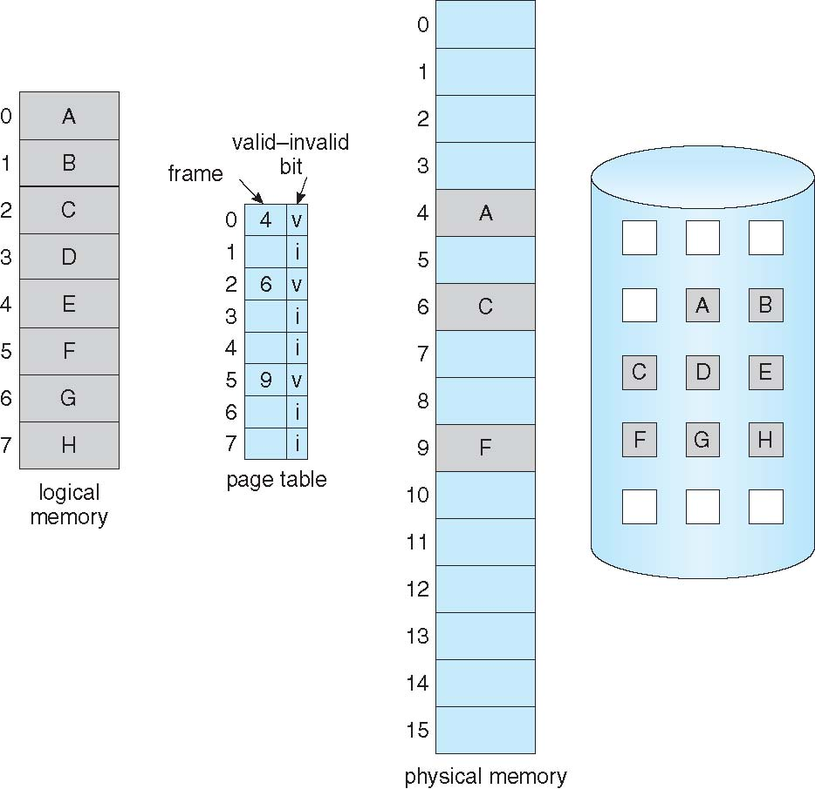
Page Table When Some Pages Are Not in Main Memory

Slide 240
Page Fault
If there is a reference to a page, first reference to that page will trap to operating system:
page fault
Operating system looks at another table to decide:
Invalid reference ⇒ abort
Just not in memory
Find free frame
Swap page into frame via scheduled disk operation
Reset tables to indicate page now in memory Set validation bit = v
Restart the instruction that caused the page fault

Slide 241

Steps in Handling a Page Fault

Slide 242
Aspects of Demand Paging
Extreme case – start process with no pages in memory
OS sets instruction pointer to first instruction of process, non-memory-resident -> page fault
And for every other process pages on first access
Pure demand paging
Actually, a given instruction could access multiple pages -> multiple page faults
Consider fetch and decode of instruction which adds 2 numbers from memory and stores result back to memory
Pain decreased because of locality of reference
Hardware support needed for demand paging
Page table with valid / invalid bit
Secondary memory (swap device with swap space)
Instruction restart

Slide 243
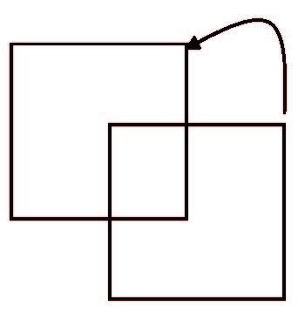
Instruction Restart
Consider an instruction that could access several different locations
block move
auto increment/decrement location
Restart the whole operation?
What if source and destination overlap?

Slide 244
Performance of Demand Paging
Stages in Demand Paging (worse case)
Trap to the operating system
Save the user registers and process state
Determine that the interrupt was a page fault
Check that the page reference was legal and determine the location of the page on the disk
Issue a read from the disk to a free frame:
Wait in a queue for this device until the read request is serviced
Wait for the device seek and/or latency time
Begin the transfer of the page to a free frame
While waiting, allocate the CPU to some other user
Receive an interrupt from the disk I/O subsystem (I/O completed)
Save the registers and process state for the other user
Determine that the interrupt was from the disk
Correct the page table and other tables to show page is now in memory
Wait for the CPU to be allocated to this process again
Restore the user registers, process state, and new page table, and then resume the interrupted instruction

Slide 245
Performance of Demand Paging (Cont.)
Three major activities
Service the interrupt – careful coding means just several hundred instructions needed
Read the page – lots of time
Restart the process – again just a small amount of time
Page Fault Rate 0 ≤ p ≤ 1
if p = 0 no page faults
if p = 1, every reference is a fault
Effective Access Time (EAT)
EAT = (1 – p) x memory access
+ p (page fault overhead
+ swap page out
+ swap page in )

Slide 246
Demand Paging Example
Memory access time = 200 nanoseconds
Average page-fault service time = 8 milliseconds
EAT = (1 – p) x 200 + p (8 milliseconds)
= (1 – p x 200 + p x 8,000,000
= 200 + p x 7,999,800
If one access out of 1,000 causes a page fault, then
EAT = 8.2 microseconds.
This is a slowdown by a factor of 40!!
If want performance degradation < 10 percent
220 > 200 + 7,999,800 x p 20 > 7,999,800 x p
p < .0000025
< one page fault in every 400,000 memory accesses

Slide 247
Demand Paging Optimizations
Swap space I/O faster than file system I/O even if on the same device
Swap allocated in larger chunks, less management needed than file system
Copy entire process image to swap space at process load time
Then page in and out of swap space
Used in older BSD Unix
Demand page in from program binary on disk, but discard rather than paging out when freeing frame
Used in Solaris and current BSD
Still need to write to swap space
Pages not associated with a file (like stack and heap) – anonymous memory
Pages modified in memory but not yet written back to the file system
Mobile systems
Typically don’t support swapping
Instead, demand page from file system and reclaim read-only pages (such as code)

Slide 248
Copy-on-Write
Copy-on-Write (COW) allows both parent and child processes to initially share the same pages in memory
If either process modifies a shared page, only then is the page copied
COW allows more efficient process creation as only modified pages are copied
In general, free pages are allocated from a pool of zero-fill-on-demand pages
Pool should always have free frames for fast demand page execution
Don’t want to have to free a frame as well as other processing on page fault
Why zero-out a page before allocating it?
vfork() variation on fork() system call has parent suspend and child using copy-on-write address space of parent
Designed to have child call exec()
Very efficient

Slide 249
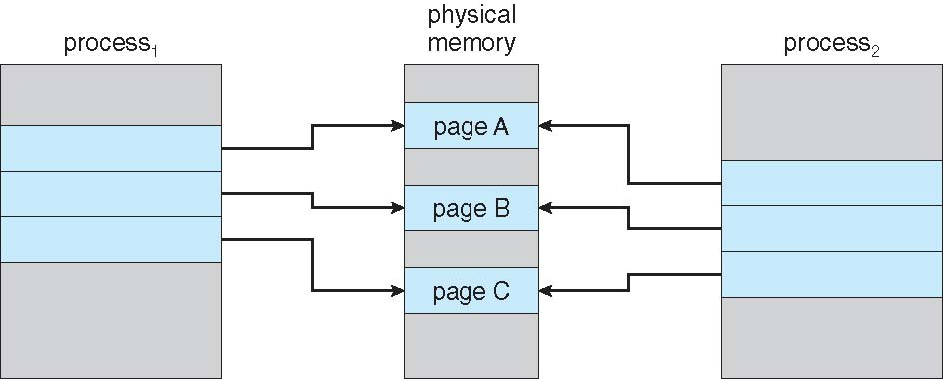
Before Process 1 Modifies Page C

Slide 250
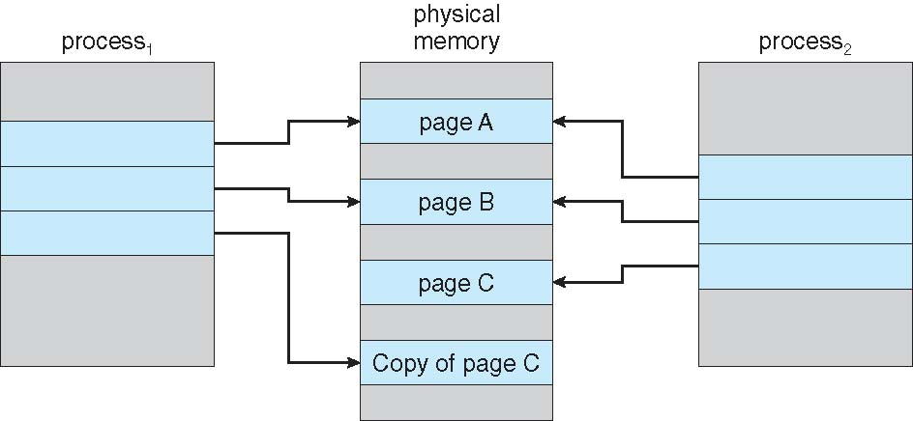
After Process 1 Modifies Page C

Slide 251
What Happens if There is no Free Frame?
Used up by process pages
Also in demand from the kernel, I/O buffers, etc
How much to allocate to each?
Page replacement – find some page in memory, but not really in use, page it out
Algorithm – terminate? swap out? replace the page?
Performance – want an algorithm which will result in minimum number of page faults
Same page may be brought into memory several times

Slide 252
Page Replacement
Prevent over-allocation of memory by modifying page-fault service routine to include page replacement
Use modify (dirty) bit to reduce overhead of page transfers – only modified pages are written to disk
Page replacement completes separation between logical memory and physical memory – large virtual memory can be provided on a smaller physical memory

Slide 253
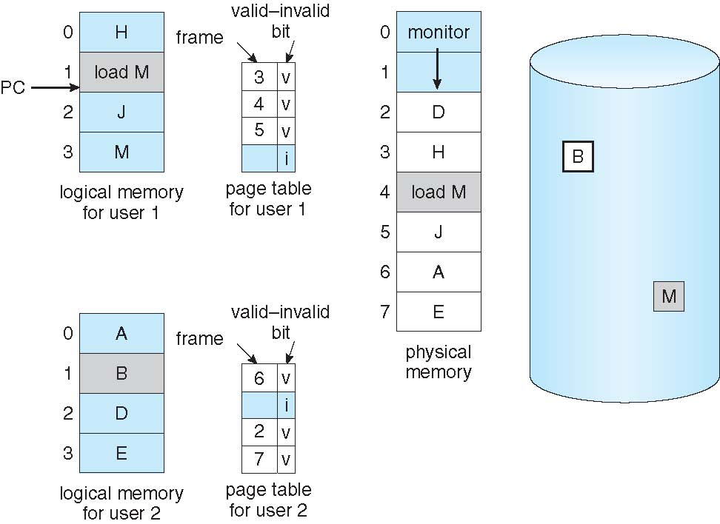
Need For Page Replacement

Slide 254
Basic Page Replacement
Find the location of the desired page on disk
Find a free frame: - If there is a free frame, use it - If there is no free frame, use a page replacement algorithm to select a victim frame - Write victim frame to disk if dirty
Bring the desired page into the (newly) free frame; update the page and frame tables
Continue the process by restarting the instruction that caused the trap
Note now potentially 2 page transfers for page fault – increasing EAT

Slide 255
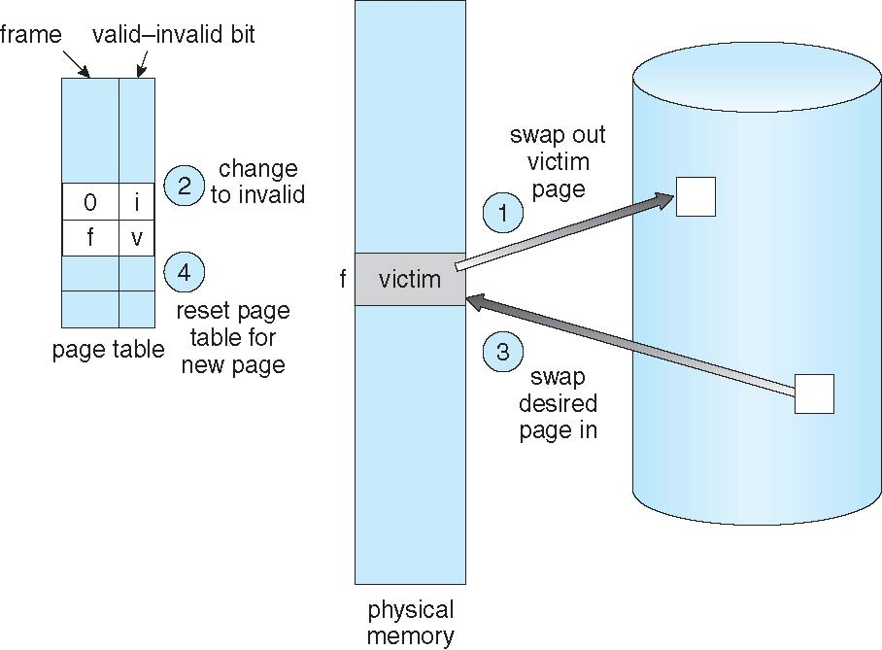
Page Replacement

Slide 256
Page and Frame Replacement Algorithms
Frame-allocation algorithm determines
How many frames to give each process
Which frames to replace
Page-replacement algorithm
Want lowest page-fault rate on both first access and re-access
Evaluate algorithm by running it on a particular string of memory references (reference string) and computing the number of page faults on that string
String is just page numbers, not full addresses
Repeated access to the same page does not cause a page fault
Results depend on number of frames available
In all our examples, the reference string of referenced page numbers is
7,0,1,2,0,3,0,4,2,3,0,3,0,3,2,1,2,0,1,7,0,1

Slide 257
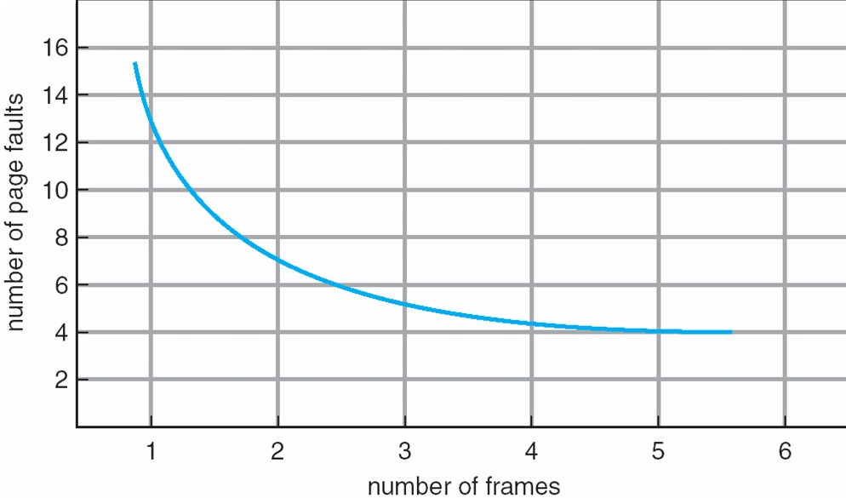
Graph of Page Faults Versus The Number of Frames

Slide 258
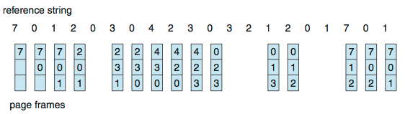
First-In-First-Out (FIFO) Algorithm
Reference string: 7,0,1,2,0,3,0,4,2,3,0,3,0,3,2,1,2,0,1,7,0,1
3 frames (3 pages can be in memory at a time per process)
Can vary by reference string: consider 1,2,3,4,1,2,5,1,2,3,4,5
Adding more frames can cause more page faults!
Belady’s Anomaly
How to track ages of pages?
Just use a FIFO queue
15 page faults

Slide 259
FIFO Illustrating Belady’s Anomaly

Slide 260

Optimal Algorithm
Replace page that will not be used for longest period of time
9 is optimal for the example
How do you know this?
Can’t read the future
Used for measuring how well your algorithm performs

Slide 261

Least Recently Used (LRU) Algorithm
Use past knowledge rather than future
Replace page that has not been used in the most amount of time
Associate time of last use with each page
12 faults – better than FIFO but worse than OPT
Generally good algorithm and frequently used
But how to implement?

Slide 262
LRU Algorithm (Cont.)
Counter implementation
Every page entry has a counter; every time page is referenced through this entry, copy the clock into the counter
When a page needs to be changed, look at the counters to find smallest value
Search through table needed
Stack implementation
Keep a stack of page numbers in a double link form:
Page referenced:
move it to the top
requires 6 pointers to be changed
But each update more expensive
No search for replacement
LRU and OPT are cases of stack algorithms that don’t have Belady’s Anomaly

Slide 263
Use Of A Stack to Record Most Recent Page References

Slide 264
LRU Approximation Algorithms
LRU needs special hardware and still slow
Reference bit
With each page associate a bit, initially = 0
When page is referenced bit set to 1
Replace any with reference bit = 0 (if one exists)
We do not know the order, however
Second-chance algorithm
Generally FIFO, plus hardware-provided reference bit
Clock replacement
If page to be replaced has
Reference bit = 0 -> replace it
reference bit = 1 then:
set reference bit 0, leave page in memory
replace next page, subject to same rules

Slide 265
Second-Chance (clock) Page-Replacement Algorithm

Slide 266
Enhanced Second-Chance Algorithm
Improve algorithm by using reference bit and modify bit (if available) in concert
Take ordered pair (reference, modify)
(0, 0) neither recently used not modified – best page to replace
(0, 1) not recently used but modified – not quite as good, must write out before replacement
(1, 0) recently used but clean – probably will be used again soon
(1, 1) recently used and modified – probably will be used again soon and need to write out before replacement
When page replacement called for, use the clock scheme but use the four classes replace page in lowest non-empty class
Might need to search circular queue several times

Slide 267
Counting Algorithms
Keep a counter of the number of references that have been made to each page
Not common
Lease Frequently Used (LFU) Algorithm: replaces page with smallest count
Most Frequently Used (MFU) Algorithm: based on the argument that the page with the smallest count was probably just brought in and has yet to be used

Slide 268
Page-Buffering Algorithms
Keep a pool of free frames, always
Then frame available when needed, not found at fault time
Read page into free frame and select victim to evict and add to free pool
When convenient, evict victim
Possibly, keep list of modified pages
When backing store otherwise idle, write pages there and set to non-dirty
Possibly, keep free frame contents intact and note what is in them
If referenced again before reused, no need to load contents again from disk
Generally useful to reduce penalty if wrong victim frame selected

Slide 269
Applications and Page Replacement
All of these algorithms have OS guessing about future page access
Some applications have better knowledge – i.e. databases
Memory intensive applications can cause double buffering
OS keeps copy of page in memory as I/O buffer
Application keeps page in memory for its own work
Operating system can given direct access to the disk, getting out of the way of the applications
Raw disk mode
Bypasses buffering, locking, etc

Slide 270
Allocation of Frames
Each process needs minimum number of frames
Example: IBM 370 – 6 pages to handle SS MOVE instruction:
instruction is 6 bytes, might span 2 pages
2 pages to handle from
2 pages to handle to
Maximum of course is total frames in the system
Two major allocation schemes
fixed allocation
priority allocation
Many variations

Slide 271
Fixed Allocation
Equal allocation – For example, if there are 100 frames (after allocating frames for the OS) and 5 processes, give each process 20 frames
Keep some as free frame buffer pool
Proportional allocation – Allocate according to the size of process
Dynamic as degree of multiprogramming, process sizes change

Slide 272
Priority Allocation
Use a proportional allocation scheme using priorities rather than size
If process P_{i} generates a page fault,
select for replacement one of its frames
select for replacement a frame from a process with lower priority number

Slide 273
Global vs. Local Allocation
Global replacement – process selects a replacement frame from the set of all frames; one process can take a frame from another
But then process execution time can vary greatly
But greater throughput so more common
Local replacement – each process selects from only its own set of allocated frames
More consistent per-process performance
But possibly underutilized memory

Slide 274
Non-Uniform Memory Access
So far all memory accessed equally
Many systems are NUMA – speed of access to memory varies
Consider system boards containing CPUs and memory, interconnected over a system bus
Optimal performance comes from allocating memory “close to” the CPU on which the thread is scheduled
And modifying the scheduler to schedule the thread on the same system board when possible
Solved by Solaris by creating lgroups
Structure to track CPU / Memory low latency groups
Used my schedule and pager
When possible schedule all threads of a process and allocate all memory for that process within the lgroup

Slide 275
Thrashing
If a process does not have “enough” pages, the page-fault rate is very high
Page fault to get page
Replace existing frame
But quickly need replaced frame back
This leads to:
Low CPU utilization
Operating system thinking that it needs to increase the degree of multiprogramming
Another process added to the system
Thrashing ≡ a process is busy swapping pages in and out

Slide 276

Thrashing (Cont.)

Slide 277
Demand Paging and Thrashing
Why does demand paging work? Locality model
Process migrates from one locality to another
Localities may overlap
Why does thrashing occur? Σ size of locality > total memory size
Limit effects by using local or priority page replacement

Slide 278
Locality In A Memory-Reference Pattern

Slide 279

Working-Set Model
Δ ≡ working-set window ≡ a fixed number of page references Example: 10,000 instructions
WSS_{i} (working set of Process P_{i}) = total number of pages referenced in the most recent Δ (varies in time)
if Δ too small will not encompass entire locality
if Δ too large will encompass several localities
if Δ = ∞ ⇒ will encompass entire program
D = Σ WSS_{i} ≡ total demand frames
Approximation of locality
if D > m ⇒ Thrashing
Policy if D > m, then suspend or swap out one of the processes

Slide 280
Keeping Track of the Working Set
Approximate with interval timer + a reference bit
Example: Δ = 10,000
Timer interrupts after every 5000 time units
Keep in memory 2 bits for each page
Whenever a timer interrupts copy and sets the values of all reference bits to 0
If one of the bits in memory = 1 ⇒ page in working set
Why is this not completely accurate?
Improvement = 10 bits and interrupt every 1000 time units

Slide 281
Page-Fault Frequency
More direct approach than WSS
Establish “acceptable” page-fault frequency (PFF) rate and use local replacement policy
If actual rate too low, process loses frame
If actual rate too high, process gains frame

Slide 282

Working Sets and Page Fault Rates
Direct relationship between working set of a process and its page-fault rate
Working set changes over time
Peaks and valleys over time

Slide 283
Chapter 10: Mass-Storage Systems
Overview of Mass Storage Structure
Disk Structure
Disk Attachment
Disk Scheduling
Disk Management
Swap-Space Management
RAID Structure
Stable-Storage Implementation

Slide 284
Objectives
To describe the physical structure of secondary storage devices and its effects on the uses of the devices
To explain the performance characteristics of mass-storage devices
To evaluate disk scheduling algorithms
To discuss operating-system services provided for mass storage, including RAID

Slide 285
Overview of Mass Storage Structure
Magnetic disks provide bulk of secondary storage of modern computers
Drives rotate at 60 to 250 times per second
Transfer rate is rate at which data flow between drive and computer
Positioning time (random-access time) is time to move disk arm to desired cylinder (seek time) and time for desired sector to rotate under the disk head (rotational latency)
Head crash results from disk head making contact with the disk surface -- That’s bad
Disks can be removable
Drive attached to computer via I/O bus
Busses vary, including EIDE, ATA, SATA, USB, Fibre Channel, SCSI, SAS, Firewire
Host controller in computer uses bus to talk to disk controller built into drive or storage array

Slide 286
Moving-head Disk Mechanism

Slide 287

Hard Disks
Platters range from .85” to 14” (historically)
Commonly 3.5”, 2.5”, and 1.8”
Range from 30GB to 3TB per drive
Performance
Transfer Rate – theoretical – 6 Gb/sec
Effective Transfer Rate – real – 1Gb/sec
Seek time from 3ms to 12ms – 9ms common for desktop drives
Average seek time measured or calculated based on 1/3 of tracks
Latency based on spindle speed
1 / (RPM / 60) = 60 / RPM
Average latency = ½ latency
(From Wikipedia)

Slide 288
Hard Disk Performance
Access Latency = Average access time = average seek time + average latency
For fastest disk 3ms + 2ms = 5ms
For slow disk 9ms + 5.56ms = 14.56ms
Average I/O time = average access time + (amount to transfer / transfer rate) + controller overhead
For example to transfer a 4KB block on a 7200 RPM disk with a 5ms average seek time, 1Gb/sec transfer rate with a .1ms controller overhead =
5ms + 4.17ms + 0.1ms + transfer time =
Transfer time = 4KB / 1Gb/s * 8Gb / GB * 1GB / 1024²KB = 32 / (1024²) = 0.031 ms
Average I/O time for 4KB block = 9.27ms + .031ms = 9.301ms

Slide 289

The First Commercial Disk Drive
1956
IBM RAMDAC computer included the IBM Model 350 disk storage system
5M (7 bit) characters
50 x 24” platters
Access time = < 1 second

Slide 290
Solid-State Disks
Nonvolatile memory used like a hard drive
Many technology variations
Can be more reliable than HDDs
More expensive per MB
Maybe have shorter life span
Less capacity
But much faster
Busses can be too slow -> connect directly to PCI for example
No moving parts, so no seek time or rotational latency

Slide 291
Magnetic Tape
Was early secondary-storage medium
Evolved from open spools to cartridges
Relatively permanent and holds large quantities of data
Access time slow
Random access ~1000 times slower than disk
Mainly used for backup, storage of infrequently-used data, transfer medium between systems
Kept in spool and wound or rewound past read-write head
Once data under head, transfer rates comparable to disk
140MB/sec and greater
200GB to 1.5TB typical storage
Common technologies are LTO-{3,4,5} and T10000

Slide 292
Disk Structure
Disk drives are addressed as large 1-dimensional arrays of logical blocks, where the logical block is the smallest unit of transfer
Low-level formatting creates logical blocks on physical media
The 1-dimensional array of logical blocks is mapped into the sectors of the disk sequentially
Sector 0 is the first sector of the first track on the outermost cylinder
Mapping proceeds in order through that track, then the rest of the tracks in that cylinder, and then through the rest of the cylinders from outermost to innermost
Logical to physical address should be easy
Except for bad sectors
Non-constant # of sectors per track via constant angular velocity

Slide 293
Disk Attachment
Host-attached storage accessed through I/O ports talking to I/O busses
SCSI itself is a bus, up to 16 devices on one cable, SCSI initiator requests operation and SCSI targets perform tasks
Each target can have up to 8 logical units (disks attached to device controller)
FC is high-speed serial architecture
Can be switched fabric with 24-bit address space – the basis of storage area networks (SANs) in which many hosts attach to many storage units
I/O directed to bus ID, device ID, logical unit (LUN)

Slide 294
Storage Array
Can just attach disks, or arrays of disks
Storage Array has controller(s), provides features to attached host(s)
Ports to connect hosts to array
Memory, controlling software (sometimes NVRAM, etc)
A few to thousands of disks
RAID, hot spares, hot swap (discussed later)
Shared storage -> more efficiency
Features found in some file systems
Snaphots, clones, thin provisioning, replication, deduplication, etc

Slide 295
Storage Area Network
Common in large storage environments
Multiple hosts attached to multiple storage arrays - flexible

Slide 296
Storage Area Network (Cont.)
SAN is one or more storage arrays
Connected to one or more Fibre Channel switches
Hosts also attach to the switches
Storage made available via LUN Masking from specific arrays to specific servers
Easy to add or remove storage, add new host and allocate it storage
Over low-latency Fibre Channel fabric
Why have separate storage networks and communications networks?
Consider iSCSI, FCOE

Slide 297

Network-Attached Storage
Network-attached storage (NAS) is storage made available over a network rather than over a local connection (such as a bus)
Remotely attaching to file systems
NFS and CIFS are common protocols
Implemented via remote procedure calls (RPCs) between host and storage over typically TCP or UDP on IP network
iSCSI protocol uses IP network to carry the SCSI protocol
Remotely attaching to devices (blocks)

Slide 298
Disk Scheduling
The operating system is responsible for using hardware efficiently — for the disk drives, this means having a fast access time and disk bandwidth
Minimize seek time
Seek time ≈ seek distance
Disk bandwidth is the total number of bytes transferred, divided by the total time between the first request for service and the completion of the last transfer

Slide 299
Disk Scheduling (Cont.)
There are many sources of disk I/O request
OS
System processes
Users processes
I/O request includes input or output mode, disk address, memory address, number of sectors to transfer
OS maintains queue of requests, per disk or device
Idle disk can immediately work on I/O request, busy disk means work must queue
Optimization algorithms only make sense when a queue exists

Slide 300
Disk Scheduling (Cont.)
Note that drive controllers have small buffers and can manage a queue of I/O requests (of varying “depth”)
Several algorithms exist to schedule the servicing of disk I/O requests
The analysis is true for one or many platters
We illustrate scheduling algorithms with a request queue (0-199)
98, 183, 37, 122, 14, 124, 65, 67
Head pointer 53

Slide 301

FCFS
Illustration shows total head movement of 640 cylinders

Slide 302

SSTF
Shortest Seek Time First selects the request with the minimum seek time from the current head position
SSTF scheduling is a form of SJF scheduling; may cause starvation of some requests
Illustration shows total head movement of 236 cylinders

Slide 303
SCAN
The disk arm starts at one end of the disk, and moves toward the other end, servicing requests until it gets to the other end of the disk, where the head movement is reversed and servicing continues.
SCAN algorithm Sometimes called the elevator algorithm
Illustration shows total head movement of 208 cylinders
But note that if requests are uniformly dense, largest density at other end of disk and those wait the longest

Slide 304

SCAN (Cont.)

Slide 305
C-SCAN
Provides a more uniform wait time than SCAN
The head moves from one end of the disk to the other, servicing requests as it goes
When it reaches the other end, however, it immediately returns to the beginning of the disk, without servicing any requests on the return trip
Treats the cylinders as a circular list that wraps around from the last cylinder to the first one
Total number of cylinders?

Slide 306

C-SCAN (Cont.)

Slide 307
C-LOOK
LOOK a version of SCAN, C-LOOK a version of C-SCAN
Arm only goes as far as the last request in each direction, then reverses direction immediately, without first going all the way to the end of the disk
Total number of cylinders?

Slide 308

C-LOOK (Cont.)

Slide 309
Selecting a Disk-Scheduling Algorithm
SSTF is common and has a natural appeal
SCAN and C-SCAN perform better for systems that place a heavy load on the disk
Less starvation
Performance depends on the number and types of requests
Requests for disk service can be influenced by the file-allocation method
And metadata layout
The disk-scheduling algorithm should be written as a separate module of the operating system, allowing it to be replaced with a different algorithm if necessary
Either SSTF or LOOK is a reasonable choice for the default algorithm
What about rotational latency?
Difficult for OS to calculate
How does disk-based queueing effect OS queue ordering efforts?

Slide 310
Disk Management
Low-level formatting, or physical formatting — Dividing a disk into sectors that the disk controller can read and write
Each sector can hold header information, plus data, plus error correction code (ECC)
Usually 512 bytes of data but can be selectable
To use a disk to hold files, the operating system still needs to record its own data structures on the disk
Partition the disk into one or more groups of cylinders, each treated as a logical disk
Logical formatting or “making a file system”
To increase efficiency most file systems group blocks into clusters
Disk I/O done in blocks
File I/O done in clusters

Slide 311
Disk Management (Cont.)
Raw disk access for apps that want to do their own block management, keep OS out of the way (databases for example)
Boot block initializes system
The bootstrap is stored in ROM
Bootstrap loader program stored in boot blocks of boot partition
Methods such as sector sparing used to handle bad blocks

Slide 312

Booting from a Disk in Windows

Slide 313
Swap-Space Management
Swap-space — Virtual memory uses disk space as an extension of main memory
Less common now due to memory capacity increases
Swap-space can be carved out of the normal file system, or, more commonly, it can be in a separate disk partition (raw)
Swap-space management
4.3BSD allocates swap space when process starts; holds text segment (the program) and data segment
Kernel uses swap maps to track swap-space use
Solaris 2 allocates swap space only when a dirty page is forced out of physical memory, not when the virtual memory page is first created
File data written to swap space until write to file system requested
Other dirty pages go to swap space due to no other home
Text segment pages thrown out and reread from the file system as needed
What if a system runs out of swap space?
Some systems allow multiple swap spaces

Slide 314
Data Structures for Swapping on Linux Systems

Slide 315
RAID Structure
RAID – redundant array of inexpensive disks
multiple disk drives provides reliability via redundancy
Increases the mean time to failure
Mean time to repair – exposure time when another failure could cause data loss
Mean time to data loss based on above factors
If mirrored disks fail independently, consider disk with 1300,000 mean time to failure and 10 hour mean time to repair
Mean time to data loss is 100, 000² / (2 ∗ 10) = 500 ∗ 10⁶ hours, or 57,000 years!
Frequently combined with NVRAM to improve write performance
Several improvements in disk-use techniques involve the use of multiple disks working cooperatively

Slide 316
RAID (Cont.)
Disk striping uses a group of disks as one storage unit
RAID is arranged into six different levels
RAID schemes improve performance and improve the reliability of the storage system by storing redundant data
Mirroring or shadowing (RAID 1) keeps duplicate of each disk
Striped mirrors (RAID 1+0) or mirrored stripes (RAID 0+1) provides high performance and high reliability
Block interleaved parity (RAID 4, 5, 6) uses much less redundancy
RAID within a storage array can still fail if the array fails, so automatic replication of the data between arrays is common
Frequently, a small number of hot-spare disks are left unallocated, automatically replacing a failed disk and having data rebuilt onto them

Slide 317
RAID Levels

Slide 318
RAID (0 + 1) and (1 + 0)

Slide 319
Other Features
Regardless of where RAID implemented, other useful features can be added
Snapshot is a view of file system before a set of changes take place (i.e. at a point in time)
More in Ch 12
Replication is automatic duplication of writes between separate sites
For redundancy and disaster recovery
Can be synchronous or asynchronous
Hot spare disk is unused, automatically used by RAID production if a disk fails to replace the failed disk and rebuild the RAID set if possible
Decreases mean time to repair

Slide 320
Chapter 11: File-System Interface
File Concept
Access Methods
Disk and Directory Structure
File-System Mounting
File Sharing
Protection

Slide 321
Objectives
To explain the function of file systems
To describe the interfaces to file systems
To discuss file-system design tradeoffs, including access methods, file sharing, file locking, and directory structures
To explore file-system protection

Slide 322
File Concept
Contiguous logical address space
Types:
Data
numeric
character
binary
Program
Contents defined by file’s creator
Many types
Consider text file, source file, executable file

Slide 323
File Attributes
Name – only information kept in human-readable form
Identifier – unique tag (number) identifies file within file system
Type – needed for systems that support different types
Location – pointer to file location on device
Size – current file size
Protection – controls who can do reading, writing, executing
Time, date, and user identification – data for protection, security, and usage monitoring
Information about files are kept in the directory structure, which is maintained on the disk
Many variations, including extended file attributes such as file checksum
Information kept in the directory structure

Slide 324

File info Window on Mac OS X

Slide 325
File Operations
File is an abstract data type
Create
Write – at write pointer location
Read – at read pointer location
Reposition within file - seek
Delete
Truncate
Open(F_{i}) – search the directory structure on disk for entry F_{i}, and move the content of entry to memory
Close (F_{i}) – move the content of entry F_{i} in memory to directory structure on disk

Slide 326
Open Files
Several pieces of data are needed to manage open files:
Open-file table: tracks open files
File pointer: pointer to last read/write location, per process that has the file open
File-open count: counter of number of times a file is open – to allow removal of data from open-file table when last processes closes it
Disk location of the file: cache of data access information
Access rights: per-process access mode information

Slide 327
Open File Locking
Provided by some operating systems and file systems
Similar to reader-writer locks
Shared lock similar to reader lock – several processes can acquire concurrently
Exclusive lock similar to writer lock
Mediates access to a file
Mandatory or advisory:
Mandatory – access is denied depending on locks held and requested
Advisory – processes can find status of locks and decide what to do

Slide 328
File Locking Example – Java API
import java.io.*;
import java.nio.channels.*;
public class LockingExample {
public static final boolean EXCLUSIVE = false;
public static final boolean SHARED = true;
public static void main(String arsg[]) throws IOException {
FileLock sharedLock = null;
FileLock exclusiveLock = null;
try {
RandomAccessFile raf = new RandomAccessFile("file.txt", "rw");
// get the channel for the file
FileChannel ch = raf.getChannel();
// this locks the first half of the file - exclusive
exclusiveLock = ch.lock(0, raf.length()/2, EXCLUSIVE);
/** Now modify the data . . . */
// release the lock
exclusiveLock.release();

Slide 329
File Locking Example – Java API (Cont.)
// this locks the second half of the file - shared
sharedLock = ch.lock(raf.length()/2+1, raf.length(), SHARED);
/** Now read the data . . . */
// release the lock
sharedLock.release();
} catch (java.io.IOException ioe) {
System.err.println(ioe);
}finally {
if (exclusiveLock != null)
exclusiveLock.release();
if (sharedLock != null)
sharedLock.release();
}
}
}

Slide 330

File Types – Name, Extension

Slide 331
File Structure
None - sequence of words, bytes
Simple record structure
Lines
Fixed length
Variable length
Complex Structures
Formatted document
Relocatable load file
Can simulate last two with first method by inserting appropriate control characters
Who decides:
Operating system
Program

Slide 332

Sequential-access File

Slide 333
Access Methods
Sequential Access
read next
write next
reset
no read after last write
(rewrite)
Direct Access – file is fixed length logical records
read n
write n
position to n
read next
write next
rewrite n
n = relative block number
Relative block numbers allow OS to decide where file should be placed
See allocation problem in Ch 12

Slide 334

Simulation of Sequential Access on Direct-access File

Slide 335
Other Access Methods
Can be built on top of base methods
General involve creation of an index for the file
Keep index in memory for fast determination of location of data to be operated on (consider UPC code plus record of data about that item)
If too large, index (in memory) of the index (on disk)
IBM indexed sequential-access method (ISAM)
Small master index, points to disk blocks of secondary index
File kept sorted on a defined key
All done by the OS
VMS operating system provides index and relative files as another example (see next slide)

Slide 336

Example of Index and Relative Files

Slide 337
Directory Structure
A collection of nodes containing information about all files
Directory
Files
F 1
F 2
F 3
F 4
F n
Both the directory structure and the files reside on disk

Slide 338
Disk Structure
Disk can be subdivided into partitions
Disks or partitions can be RAID protected against failure
Disk or partition can be used raw – without a file system, or formatted with a file system
Partitions also known as minidisks, slices
Entity containing file system known as a volume
Each volume containing file system also tracks that file system’s info in device directory or volume table of contents
As well as general-purpose file systems there are many special-purpose file systems, frequently all within the same operating system or computer

Slide 339

A Typical File-system Organization

Slide 340
Types of File Systems
We mostly talk of general-purpose file systems
But systems frequently have may file systems, some general- and some special- purpose
Consider Solaris has
tmpfs – memory-based volatile FS for fast, temporary I/O
objfs – interface into kernel memory to get kernel symbols for debugging
ctfs – contract file system for managing daemons
lofs – loopback file system allows one FS to be accessed in place of another
procfs – kernel interface to process structures
ufs, zfs – general purpose file systems

Slide 341
Operations Performed on Directory
Search for a file
Create a file
Delete a file
List a directory
Rename a file
Traverse the file system

Slide 342
Directory Organization
The directory is organized logically to obtain
Efficiency – locating a file quickly
Naming – convenient to users
Two users can have same name for different files
The same file can have several different names
Grouping – logical grouping of files by properties, (e.g., all Java programs, all games, …)

Slide 343

Single-Level Directory
A single directory for all users
Naming problem
Grouping problem

Slide 344

Two-Level Directory
Separate directory for each user
Path name
Can have the same file name for different user
Efficient searching
No grouping capability

Slide 345

Tree-Structured Directories

Slide 346
Tree-Structured Directories (Cont.)
Efficient searching
Grouping Capability
Current directory (working directory)
cd /spell/mail/prog
type list

Slide 347

Tree-Structured Directories (Cont)
Absolute or relative path name
Creating a new file is done in current directory
Delete a file
rm <file-name>
Creating a new subdirectory is done in current directory
mkdir <dir-name>
Example: if in current directory /mail
mkdir count
Deleting “mail” ⇒ deleting the entire subtree rooted by “mail”

Slide 348

Acyclic-Graph Directories
Have shared subdirectories and files

Slide 349
Acyclic-Graph Directories (Cont.)
Two different names (aliasing)
If dict deletes list ⇒ dangling pointer
Solutions:
Backpointers, so we can delete all pointers Variable size records a problem
Backpointers using a daisy chain organization
Entry-hold-count solution
New directory entry type
Link – another name (pointer) to an existing file
Resolve the link – follow pointer to locate the file

Slide 350

General Graph Directory

Slide 351
General Graph Directory (Cont.)
How do we guarantee no cycles?
Allow only links to file not subdirectories
Garbage collection
Every time a new link is added use a cycle detection algorithm to determine whether it is OK

Slide 352
File System Mounting
A file system must be mounted before it can be accessed
A unmounted file system (i.e., Fig. 11-11(b)) is mounted at a mount point

Slide 353

Mount Point

Slide 354
File Sharing
Sharing of files on multi-user systems is desirable
Sharing may be done through a protection scheme
On distributed systems, files may be shared across a network
Network File System (NFS) is a common distributed file-sharing method
If multi-user system
User IDs identify users, allowing permissions and protections to be per-user Group IDs allow users to be in groups, permitting group access rights
Owner of a file / directory
Group of a file / directory

Slide 355
File Sharing – Remote File Systems
Uses networking to allow file system access between systems
Manually via programs like FTP
Automatically, seamlessly using distributed file systems
Semi automatically via the world wide web
Client-server model allows clients to mount remote file systems from servers
Server can serve multiple clients
Client and user-on-client identification is insecure or complicated
NFS is standard UNIX client-server file sharing protocol
CIFS is standard Windows protocol
Standard operating system file calls are translated into remote calls
Distributed Information Systems (distributed naming services) such as LDAP, DNS, NIS, Active Directory implement unified access to information needed for remote computing

Slide 356
File Sharing – Failure Modes
All file systems have failure modes
For example corruption of directory structures or other non-user data, called metadata
Remote file systems add new failure modes, due to network failure, server failure
Recovery from failure can involve state information about status of each remote request
Stateless protocols such as NFS v3 include all information in each request, allowing easy recovery but less security

Slide 357
File Sharing – Consistency Semantics
Specify how multiple users are to access a shared file simultaneously
Similar to Ch 5 process synchronization algorithms
Tend to be less complex due to disk I/O and network latency (for remote file systems
Andrew File System (AFS) implemented complex remote file sharing semantics
Unix file system (UFS) implements:
Writes to an open file visible immediately to other users of the same open file
Sharing file pointer to allow multiple users to read and write concurrently
AFS has session semantics
Writes only visible to sessions starting after the file is closed

Slide 358
Protection
File owner/creator should be able to control:
what can be done
by whom
Types of access
Read
Write
Execute
Append
Delete
List

Slide 359

Access Lists and Groups
Mode of access: read, write, execute
Three classes of users on Unix / Linux
RWX
a) owner access 7 ⇒ 1 1 1 RWX
b) group access 6 ⇒ 1 1 0
RWX
c) public access 1 ⇒ 0 0 1
Ask manager to create a group (unique name), say G, and add some users to the group.
For a particular file (say game) or subdirectory, define an appropriate access.
Attach a group to a file chgrp G game

Slide 360
Chapter 13: I/O Systems
Overview
I/O Hardware
Application I/O Interface
Kernel I/O Subsystem
Transforming I/O Requests to Hardware Operations
STREAMS
Performance

Slide 361
Objectives
Explore the structure of an operating system’s I/O subsystem
Discuss the principles of I/O hardware and its complexity
Provide details of the performance aspects of I/O hardware and software

Slide 362
Overview
I/O management is a major component of operating system design and operation
Important aspect of computer operation
I/O devices vary greatly
Various methods to control them
Performance management
New types of devices frequent
Ports, busses, device controllers connect to various devices
Device drivers encapsulate device details
Present uniform device-access interface to I/O subsystem

Slide 363
I/O Hardware
Incredible variety of I/O devices
Storage
Transmission
Human-interface
Common concepts – signals from I/O devices interface with computer
Port – connection point for device
Bus - daisy chain or shared direct access
PCI bus common in PCs and servers, PCI Express (PCIe)
expansion bus connects relatively slow devices
Controller (host adapter) – electronics that operate port, bus, device
Sometimes integrated
Sometimes separate circuit board (host adapter)
Contains processor, microcode, private memory, bus controller, etc
Some talk to per-device controller with bus controller, microcode, memory, etc

Slide 364

A Typical PC Bus Structure

Slide 365
I/O Hardware (Cont.)
I/O instructions control devices
Devices usually have registers where device driver places commands, addresses, and data to write, or read data from registers after command execution
Data-in register, data-out register, status register, control register
Typically 1-4 bytes, or FIFO buffer
Devices have addresses, used by
Direct I/O instructions
Memory-mapped I/O
Device data and command registers mapped to processor address space
Especially for large address spaces (graphics)

Slide 366

Device I/O Port Locations on PCs (partial)

Slide 367
Polling
For each byte of I/O
Read busy bit from status register until 0
Host sets read or write bit and if write copies data into data-out register
Host sets command-ready bit
Controller sets busy bit, executes transfer
Controller clears busy bit, error bit, command-ready bit when transfer done
Step 1 is busy-wait cycle to wait for I/O from device
Reasonable if device is fast
But inefficient if device slow
CPU switches to other tasks?
But if miss a cycle data overwritten / lost

Slide 368
Interrupts
Polling can happen in 3 instruction cycles
Read status, logical-and to extract status bit, branch if not zero
How to be more efficient if non-zero infrequently?
CPU Interrupt-request line triggered by I/O device
Checked by processor after each instruction
Interrupt handler receives interrupts
Maskable to ignore or delay some interrupts
Interrupt vector to dispatch interrupt to correct handler
Context switch at start and end
Based on priority
Some nonmaskable
Interrupt chaining if more than one device at same interrupt number

Slide 369

Interrupt-Driven I/O Cycle

Slide 370

Intel Pentium Processor Event-Vector Table

Slide 371
Interrupts (Cont.)
Interrupt mechanism also used for exceptions
Terminate process, crash system due to hardware error
Page fault executes when memory access error
System call executes via trap to trigger kernel to execute request
Multi-CPU systems can process interrupts concurrently
If operating system designed to handle it
Used for time-sensitive processing, frequent, must be fast

Slide 372
Direct Memory Access
Used to avoid programmed I/O (one byte at a time) for large data movement
Requires DMA controller
Bypasses CPU to transfer data directly between I/O device and memory
OS writes DMA command block into memory
Source and destination addresses
Read or write mode
Count of bytes
Writes location of command block to DMA controller
Bus mastering of DMA controller – grabs bus from CPU
Cycle stealing from CPU but still much more efficient
When done, interrupts to signal completion
Version that is aware of virtual addresses can be even more efficient - DVMA

Slide 373
Six Step Process to Perform DMA Transfer

Slide 374
Application I/O Interface
I/O system calls encapsulate device behaviors in generic classes
Device-driver layer hides differences among I/O controllers from kernel
New devices talking already-implemented protocols need no extra work
Each OS has its own I/O subsystem structures and device driver frameworks
Devices vary in many dimensions
Character-stream or block
Sequential or random-access
Synchronous or asynchronous (or both)
Sharable or dedicated
Speed of operation
read-write, read only, or write only

Slide 375

A Kernel I/O Structure

Slide 376

Characteristics of I/O Devices

Slide 377
Characteristics of I/O Devices (Cont.)
Subtleties of devices handled by device drivers
Broadly I/O devices can be grouped by the OS into
Block I/O
Character I/O (Stream)
Memory-mapped file access
Network sockets
For direct manipulation of I/O device specific characteristics, usually an escape / back door
Unix ioctl() call to send arbitrary bits to a device control register and data to device data register

Slide 378
Block and Character Devices
Block devices include disk drives
Commands include read, write, seek
Raw I/O, direct I/O, or file-system access
Memory-mapped file access possible
File mapped to virtual memory and clusters brought via demand paging
DMA
Character devices include keyboards, mice, serial ports
Commands include get(), put()
Libraries layered on top allow line editing

Slide 379
Network Devices
Varying enough from block and character to have own interface
Linux, Unix, Windows and many others include socket interface
Separates network protocol from network operation
Includes select() functionality
Approaches vary widely (pipes, FIFOs, streams, queues, mailboxes)

Slide 380
Clocks and Timers
Provide current time, elapsed time, timer
Normal resolution about 1/60 second
Some systems provide higher-resolution timers
Programmable interval timer used for timings, periodic interrupts
ioctl() (on UNIX) covers odd aspects of I/O such as clocks and timers

Slide 381
Nonblocking and Asynchronous I/O
Blocking - process suspended until I/O completed
Easy to use and understand
Insufficient for some needs
Nonblocking - I/O call returns as much as available
User interface, data copy (buffered I/O)
Implemented via multi-threading
Returns quickly with count of bytes read or written
select() to find if data ready then read() or write() to transfer
Asynchronous - process runs while I/O executes
Difficult to use
I/O subsystem signals process when I/O completed

Slide 382

Two I/O Methods
Synchronous
Asynchronous

Slide 383
Vectored I/O
Vectored I/O allows one system call to perform multiple I/O operations
For example, Unix readve() accepts a vector of multiple buffers to read into or write from
This scatter-gather method better than multiple individual I/O calls
Decreases context switching and system call overhead
Some versions provide atomicity
Avoid for example worry about multiple threads changing data as reads / writes occurring

Slide 384
Kernel I/O Subsystem
Scheduling
Some I/O request ordering via per-device queue
Some OSs try fairness
Some implement Quality Of Service (i.e. IPQOS)
Buffering - store data in memory while transferring between devices
To cope with device speed mismatch
To cope with device transfer size mismatch
To maintain “copy semantics”
Double buffering – two copies of the data
Kernel and user
Varying sizes
Full / being processed and not-full / being used
Copy-on-write can be used for efficiency in some cases

Slide 385

Device-status Table

Slide 386
Sun Enterprise 6000 Device-Transfer Rates

Slide 387
Kernel I/O Subsystem
Caching - faster device holding copy of data
Always just a copy
Key to performance
Sometimes combined with buffering
Spooling - hold output for a device
If device can serve only one request at a time
i.e., Printing
Device reservation - provides exclusive access to a device
System calls for allocation and de-allocation
Watch out for deadlock

Slide 388
Error Handling
OS can recover from disk read, device unavailable, transient write failures
Retry a read or write, for example
Some systems more advanced – Solaris FMA, AIX
Track error frequencies, stop using device with increasing frequency of retry-able errors
Most return an error number or code when I/O request fails
System error logs hold problem reports

Slide 389
I/O Protection
User process may accidentally or purposefully attempt to disrupt normal operation via illegal I/O instructions
All I/O instructions defined to be privileged
I/O must be performed via system calls
Memory-mapped and I/O port memory locations must be protected too

Slide 390
Use of a System Call to Perform I/O

Slide 391
Kernel Data Structures
Kernel keeps state info for I/O components, including open file tables, network connections, character device state
Many, many complex data structures to track buffers, memory allocation, “dirty” blocks
Some use object-oriented methods and message passing to implement I/O
Windows uses message passing
Message with I/O information passed from user mode into kernel
Message modified as it flows through to device driver and back to process
Pros / cons?

Slide 392
UNIX I/O Kernel Structure

Slide 393
Power Management
Not strictly domain of I/O, but much is I/O related
Computers and devices use electricity, generate heat, frequently require cooling
OSes can help manage and improve use
Cloud computing environments move virtual machines between servers
Can end up evacuating whole systems and shutting them down
Mobile computing has power management as first class OS aspect

Slide 394
Power Management (Cont.)
For example, Android implements
Component-level power management
Understands relationship between components
Build device tree representing physical device topology
System bus -> I/O subsystem -> {flash, USB storage}
Device driver tracks state of device, whether in use
Unused component – turn it off
All devices in tree branch unused – turn off branch
Wake locks – like other locks but prevent sleep of device when lock is held
Power collapse – put a device into very deep sleep
Marginal power use
Only awake enough to respond to external stimuli (button press, incoming call)

Slide 395
I/O Requests to Hardware Operations
Consider reading a file from disk for a process:
Determine device holding file
Translate name to device representation
Physically read data from disk into buffer
Make data available to requesting process
Return control to process

Slide 396

Life Cycle of An I/O Request

Slide 397
STREAMS
STREAM – a full-duplex communication channel between a user-level process and a device in Unix System V and beyond
A STREAM consists of:
STREAM head interfaces with the user process
driver end interfaces with the device
zero or more STREAM modules between them
Each module contains a read queue and a write queue
Message passing is used to communicate between queues
Flow control option to indicate available or busy
Asynchronous internally, synchronous where user process communicates with stream head

Slide 398

The STREAMS Structure

Slide 399
Performance
I/O a major factor in system performance:
Demands CPU to execute device driver, kernel I/O code
Context switches due to interrupts
Data copying
Network traffic especially stressful

Slide 400
Intercomputer Communications

Slide 401
Improving Performance
Reduce number of context switches
Reduce data copying
Reduce interrupts by using large transfers, smart controllers, polling
Use DMA
Use smarter hardware devices
Balance CPU, memory, bus, and I/O performance for highest throughput
Move user-mode processes / daemons to kernel threads

Slide 402
Device-Functionality Progression

